Slide 1
COMPLIANCE CAFE
OFFICE OF SPONSORED PROJECTS
INITIATIVES TO SUPPORT CLINICAL RESEARCH AT THE UNIVERSITY OF UTAH
Kevin Peterson, JD, CRA
Associate Director, Clinical Research
Office of Sponsored Projects
Notes:
My name is Kevin Peterson
I am the Associate Director of Clinical Research in OSP
It is a new position at the University in OSP and I have been in the position for 2 months
Prior to starting this position, I was the Executive Director of Sponsored Programs at Utah State University for the past 10 years.
That said, I started out my career in research administration straight out of law school working in OSP on clinical trials and eventually worked on industry sponsored research agreements and grant proposals and awards.

Slide 2
Vision Statement
The Office of Sponsored Projects provides expertise to support research growth and stewardship of sponsored funding. We foster strong and collaborative relationships through integrity, outstanding service, and communication. We increase efficiency and support compliance in research administration through innovation and technology.
Notes:
-Expertise
-Establish collaborative relationships
-Utilize systems to navigate research admin processes
Research administration is relationship based
Our goal is to develop and maintain positive and supportive relationships with this with whom we work and interact.
Increase efficiency
Away for 10 years and I was impressed when I came back with the number of electronic systems implemented to improve efficiency
I remember the days of the sneakernet---run around gathering signature---and now we have an electronic system that is auditable, where we can collect data to see how we are doing and identify issues.

Slide 3
Purpose Statement
OSP supports faculty through effective management of extramural sponsored proposals and awards funded by federal and state agencies, foundations, and other public and private sources. OSP is primarily responsible for interpreting and ensuring compliance with University policy, proposal and award terms and conditions, and applicable federal and state laws and regulations. OSP reviews and submits proposals on behalf of the University. We also draft, negotiate, and sign sponsored agreements and subawards.
Notes:
To narrow things down a bit further for clinical trials, in addition to negotiating CTAs, we help mitigate risks inherent in conducting clinical research and work with other compliance offices that have a role in clinical research (eg, ICF review and coordination with IRB, etc.).
Our job is to mitigate the risk of conducting clinical research. Our goal is to negotiate good language in a clinical trial agreement that protects the university, the PI, the study team, and study subjects so that the PI and study team can focus on conducting the clinical trial.
To the extent that there are issues, we highlight those and address them up front to minimize compliance surprises during the conduct of the study.

Slide 4
OSP Clinical Trials Team Initiatives
Solidify Team Structure
Expand Resources
Increase Transparency
Visible Presence
Assess Performance
Notes:
Initiatives in 2023 (prep work in Fall 2022). Briefly review all 5 initiatives:
(1) Solidify Team Structure
(2) Expand Resources
(3) Increase Transparency
(4) Assess Performance
(5) Visible Presence

Slide 5
OSP Clinical Trials Team Initiatives
Solidify Team Structure
Notes:
(1) Develop, promote, and maintain a team of experts who understand the clinical trial process and possess effective customer service skills.

Slide 6
OSP ORGANIZATIONAL CHART - Historic
Director
Brent Brown
Industry Team
Assistant
Ylia Lopez
Grants Team
Associate Director:
Todd Nilsen
Associate Director: Grants
Kristie Thompson
Contract Officers
Project Managers
SPO - Grant Officers
Timothy Tripp
Elisabeth Zuniga
Trevor Gordon
Chris Hardy
Tara Merrill
Julian Tippetts
Gary Christensen TBD
Douglas Wawrzynski
Rob Potts
Michael Rasmussen
Erick Batres
Rohmee Gonzales
Todd Bjorklund (75%)
Katelyn Dalley
Laurel Duncan (75%)
Hailey Palmer
Mary Mulvey
Rebecca G.
Annie Horne
Jenny Hoskins
Isabella Johnson (75%)
Shauna Petersen
Erica Trejo
Kathy Christiansen
Todd Bjorklund
(Pre-Award 25%)
Laurel Duncan
(Communications 25%)
Isabella Johnson
(Post-Award 25%)
Trevor Gordon
(Employee Achievement 25%)
Contract Administrator
Lona Gordon
Graphics and Media Specialist
Tara Mleynek
Grant/Contract Administrators
Steven Balls (Hailey Palmer- Replacement TBD)
Staff Specialist (Legal Interns)
Colton C., Hayley M., Amanda S.
Computer Specialist
Darren Gonzol
Administrative Assistant
Britney Fuger
Notes:
OSP previously had one team designated for contracts (clinical and industry sponsored research combined into one team)
The university/OSP view clinical trials and an areas that is critical and that deserves special expertise, which is why we are building the team and strengthening the team structure
The team structure we are building looks like this....

Slide 7
OSP Organizational Chart: Clinical Trials Team
Kevin Peterson
Associate Director
Trevor Gordon
Sponsored Programs Officer
Timothy Tripp
Sponsored Programs Officer
Tara Merrill
Sponsored Programs Officer
Mike Rasmussen
Sponsored Programs Officer
Julian Tippets
Sponsored Programs Officer
Eric Lazenby
Sponsored Programs Officer
Elisabeth Zuniga
Sponsored Programs Officer
Open
Jon Cantu
Sponsored Programs Officer (CDAs)
James Borshell
Sponsored Programs Officer
Notes:
Start with the creation of Associate Director role and what that role is
Manage and support the OSP Clinical Trials team
Monitor and oversee existing research operations, resources, compliance processes, and the needs of clinical team
Build and maintain compliant infrastructure, policies and practice
Develop staffing plans and ensure proper training
Communicate new policies, procedures, and training opportunities to faculty and staff
Manage the submission of clinical trial contracts/ amendments, and associated agreements
Support

Slide 8
OSP Organizational Chart: Clinical Trials Team
Kevin Peterson
Associate Director
Manager
Trevor Gordon
Sponsored Programs Officer
Timothy Tripp
Sponsored Programs Officer
Tara Merrill
Sponsored Programs Officer
Mike Rasmussen
Sponsored Programs Officer
Julian Tippets
Sponsored Programs Officer
Eric Lazenby
Sponsored Programs Officer
Elisabeth Zuniga
Sponsored Programs Officer
Open
Jon Cantu
Sponsored Programs Officer (CDAs)
James Borshell
Sponsored Programs Officer
Notes:
We are looking to add on to the team structure by adding a manger.
Manager position: a senior level individual that is an expert with clinical trials that can support the OSP clinical trial team, troubleshoot issues, and address needs and concerns as they arise. Someone who will focus on initiatives to support the OSP clinical trial team and campus.
Create tiered SPO positions in the office to offer opportunities for professional growth within OSP and provide improved mentoring for new staff.

Slide 9
OSP Clinical Trials Team Initiatives
Solidify Team Structure
Expand Resources
Notes:
Create new and improve existing resources.
REDs trainings, Clinical Resource Guidance Document, website
ReviewClinical Resource Guidance Document

Slide 10
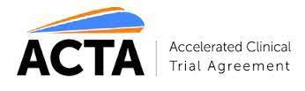

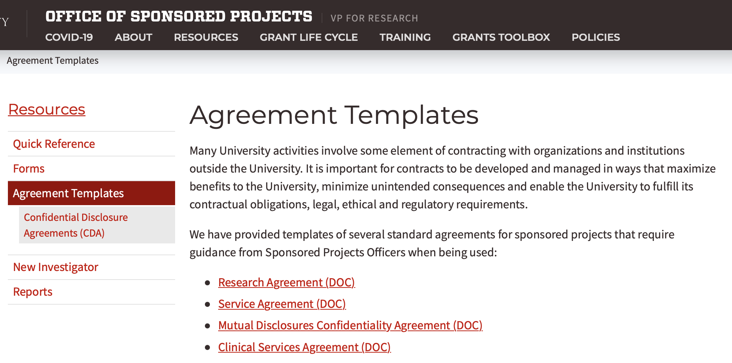
Expand Resources
Accelerated Clinical Trial Agreement
Master Agreements
Agreement templates
Training materials
OSP website
Process clarification
  Clinical Trial Guidance Document
Notes:
ACTA: an agreement that is acceptable to us (the U) participating institutions and organizations---number of pharmaceutical companies have agreed to the ACTA; when used, the ACTA will expedite the study initiation process.
Master Agreements: where it makes sense, renew existing MCTAs and work with common sponsors on getting an MCTA in place
Updating existing agreement templates
Developing training materials for internal OSP staff and PIs and study teams
Maintaining current policies on website and developing more robust content
Processes: Clinical Trial Guidance Document

Slide 11
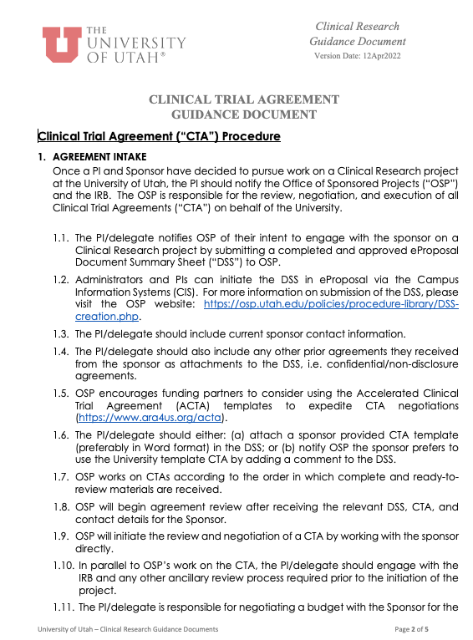
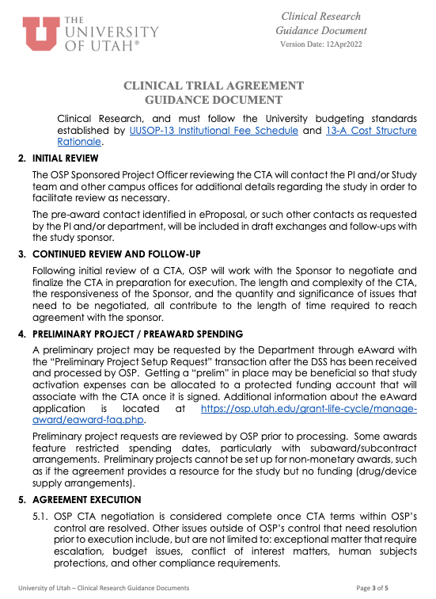
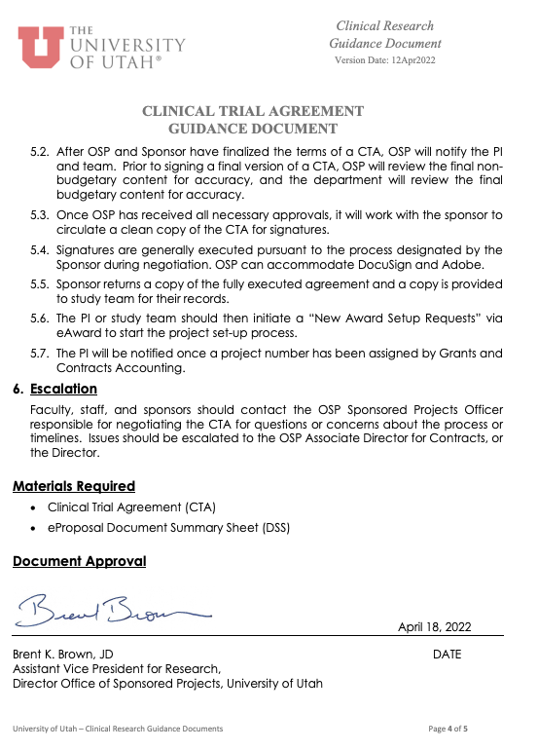
Clinical Trial Agreement Guidance Document
Continued Review
Preaward Spending
Agreement Execution
Initial Review
Agreement Intake
Notes:
This takes a cradle to grave approach to working with OSP on a CTA

Slide 12
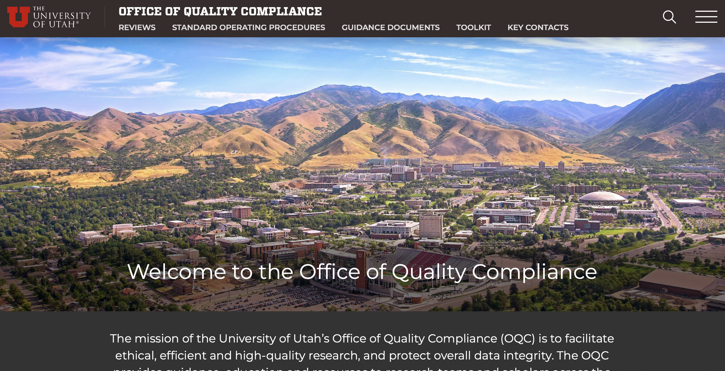
https://qualitycompliance.research.utah.edu

Slide 13
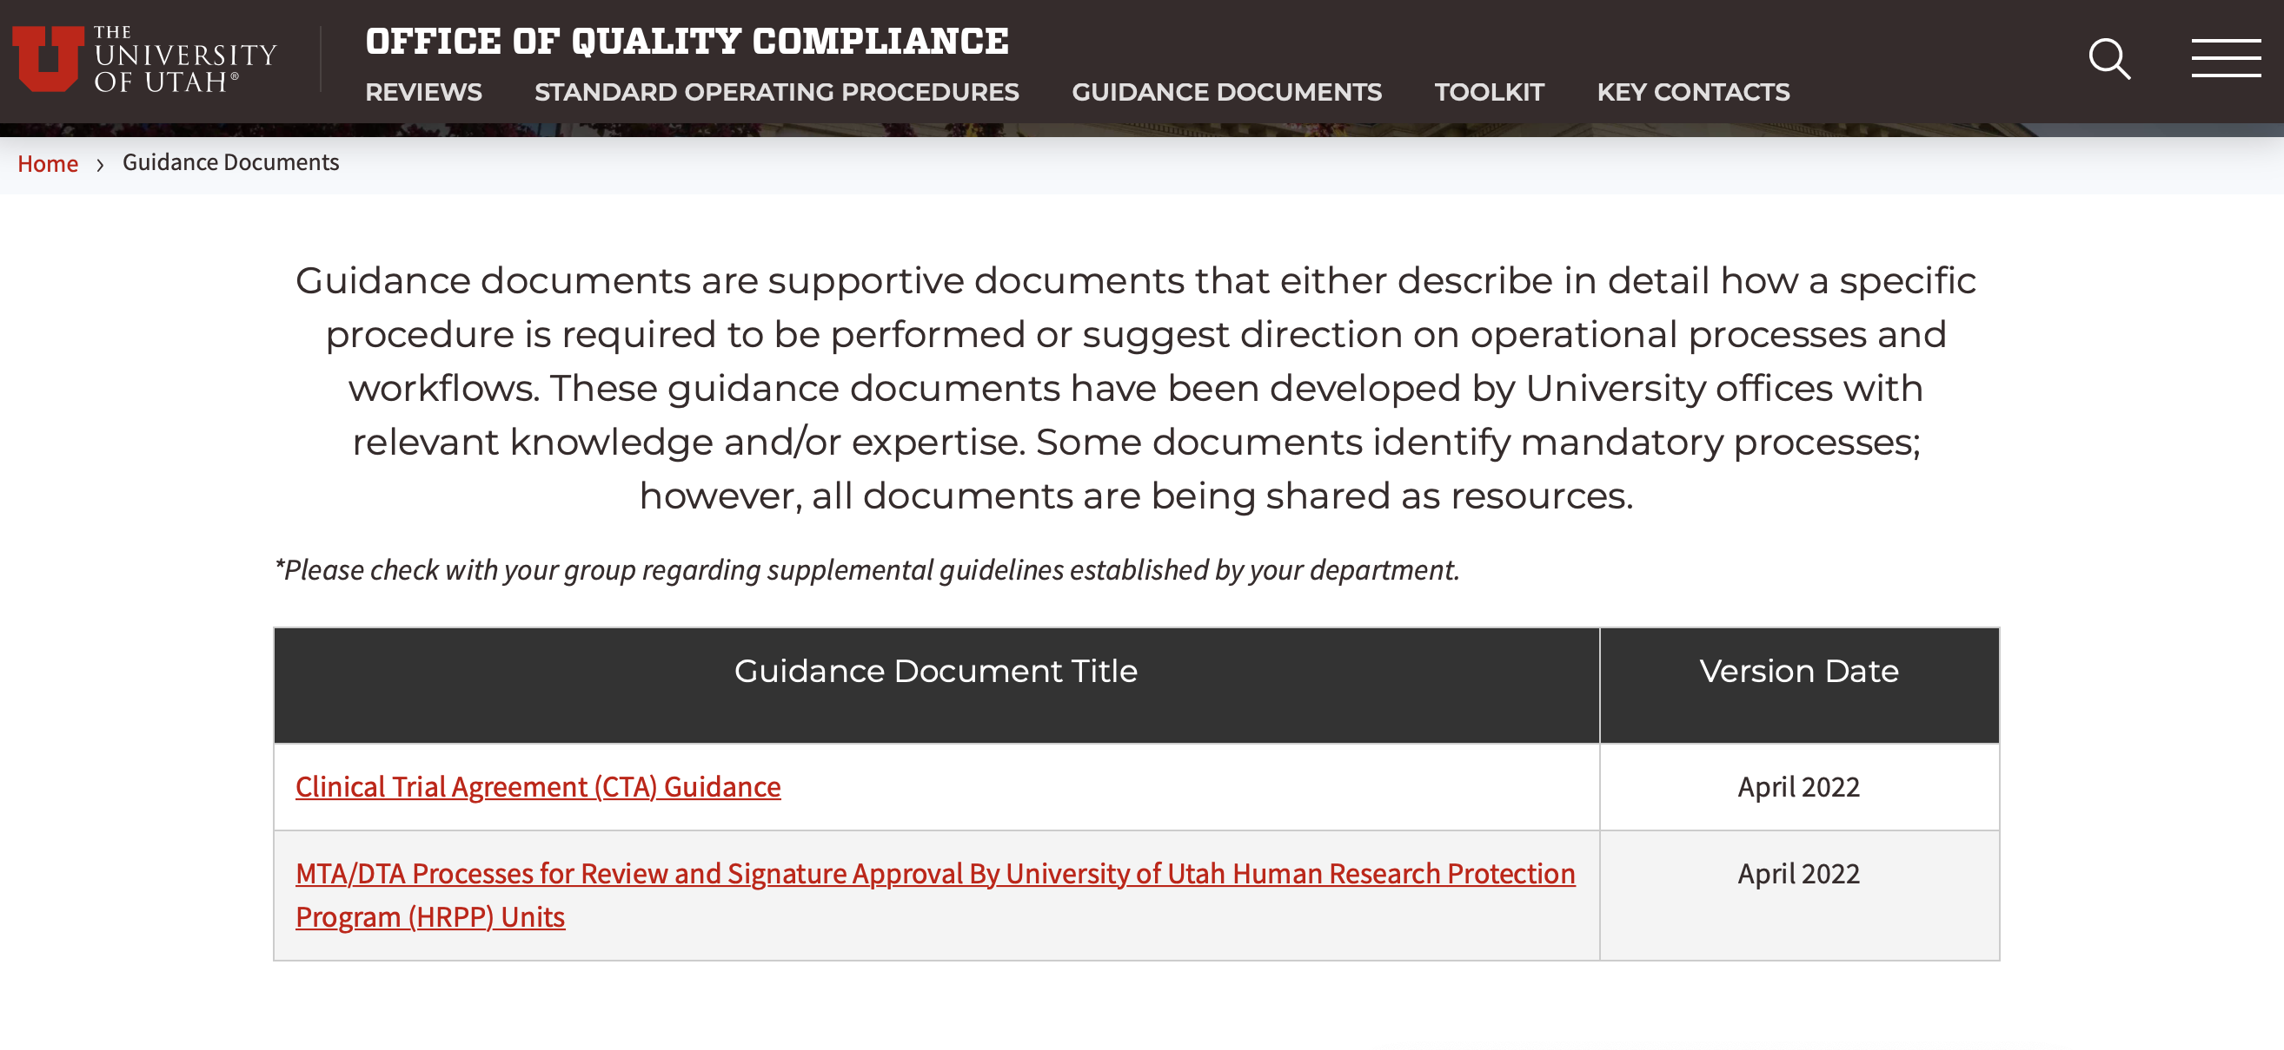

Slide 14
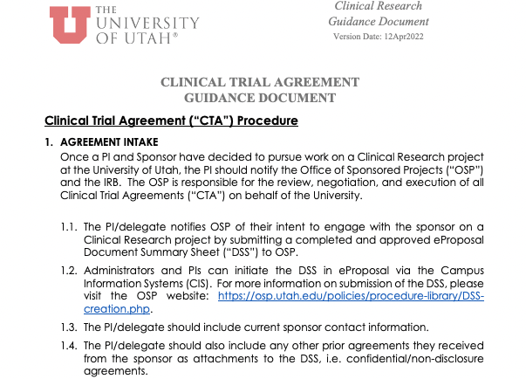
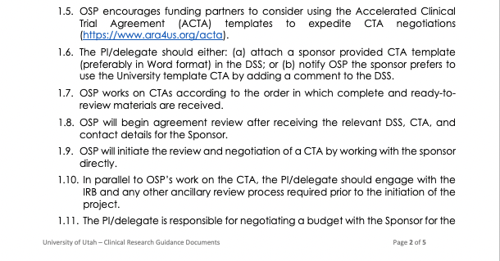
Agreement Intake
Notes:
The key here is to utilize eProposal when initiating a new clinical study: attach the CTA in eProposal—receiving the DSS, CTA and sponsor contact information is what starts the clock for OSP

Slide 15
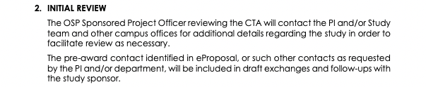
Initial Review
Notes:
OSP will make a concerted effort to keep you in the loop

Slide 16
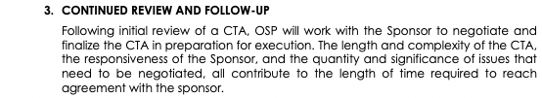
Continued Review
Notes:
Communication will continue throughout the process

Slide 17
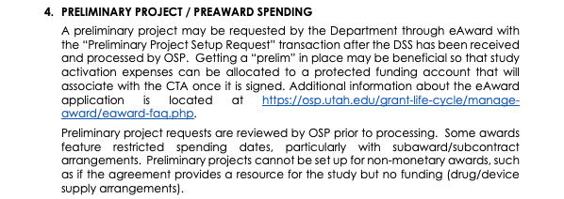
Preaward Spending
Notes:
If you need a preliminary project number to allow for preaward spending AND it is allowed by the sponsor, a preliminary project set up request needs to be submitted in eAward (this would be after the DSS has been received and processed by OSP in eProposal)

Slide 18
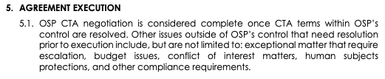
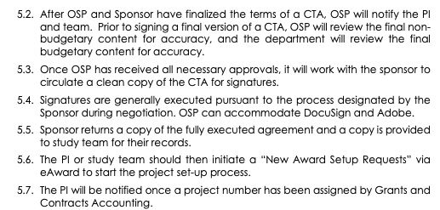
Agreement Execution
Notes:
Once the agreement is finalized, PI or study team needs to initiate a New Award Set up Request in eAward

Slide 19
Clinical Trial Agreement Guidance Document
ESCALATION
Faculty, staff, and sponsors should contact the OSP Sponsored Projects Officer responsible for negotiating the CTA for questions or concerns about the process or timelines. Issues should be escalated to the OSP Associate Director for Clinical Research, or the OSP Director.
Continued Review
Preaward Spending
Agreement Execution
Initial Review
Agreement Intake
RESOLUTION
Notes:
If there are issues, please first contact your assigned SPO. If those issued need to be escalated, please reach out to me.
I prefer to point a finger at an issue and not an individual.
Let's address the issue, learn from it, and move on to be better.

Slide 20
OSP Clinical Trials Team Initiatives
Solidify Team Structure
Expand Resources
Increase Transparency

Slide 21



Increase Transparency
  Use information systems to track and manage sponsored agreements through the project lifecycle and regularly collect information and metrics related to contracting and sponsored program management.
Notes:
Electronic systems allow us to track data and create metrics to review. Agiloft is a contracting system that we are looking to better utilize to track turnaround time and gather data. Assign accounts.
We are trying to utilize systems that are accessible and create an extra layer of transparency so that information and data related to CTA negotiatons are not siloed in SPO.

Slide 22
OSP Clinical Trials Team Initiatives
Solidify Team Structure
Expand Resources
Increase Transparency
Assess Performance

Slide 23

Assess Team Performance
Workload management and utilization of metrics to assess turnaround times and break points
Notes:
OSP team has been working hard to maintain good turn around times---even with turnover and losing staff. We are looking at ways to more evenly distribute workload and maintain a high level of performance.
In order to do that, we utilize a number of ways to assess performance.
One of the ways is to collect and review better data.
I just talked about how we are trying to better utilize our information systems to create transparency-----those same systems allow us to assess individual and team performance to make sure we are doing what we are responsible for doing.

Slide 24
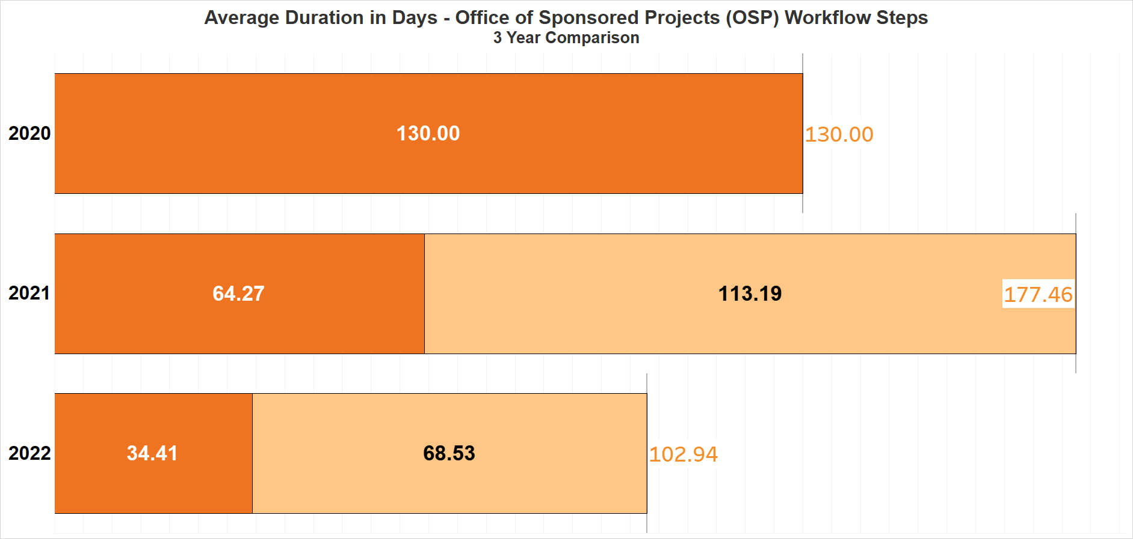
Notes:
In terms of turnaround. This metrics shows the average duration in days, that (1) a CTA takes to be completed in OSP and (2) the average duration in days that a CTA takes to be executed/signed after it has been completed in OSP
Dark Orange: starts when OSP has everything it needs to begin a CTA negotiation (DSS in eProposal, sponsor contact information, CTA template) and ends when all CTA terms within OSP's control are resolved.
The light orange/yellow: starts when the CTA terms within OSP's control are resolved and ends when final signatures on the CTA are obtained.

Slide 25
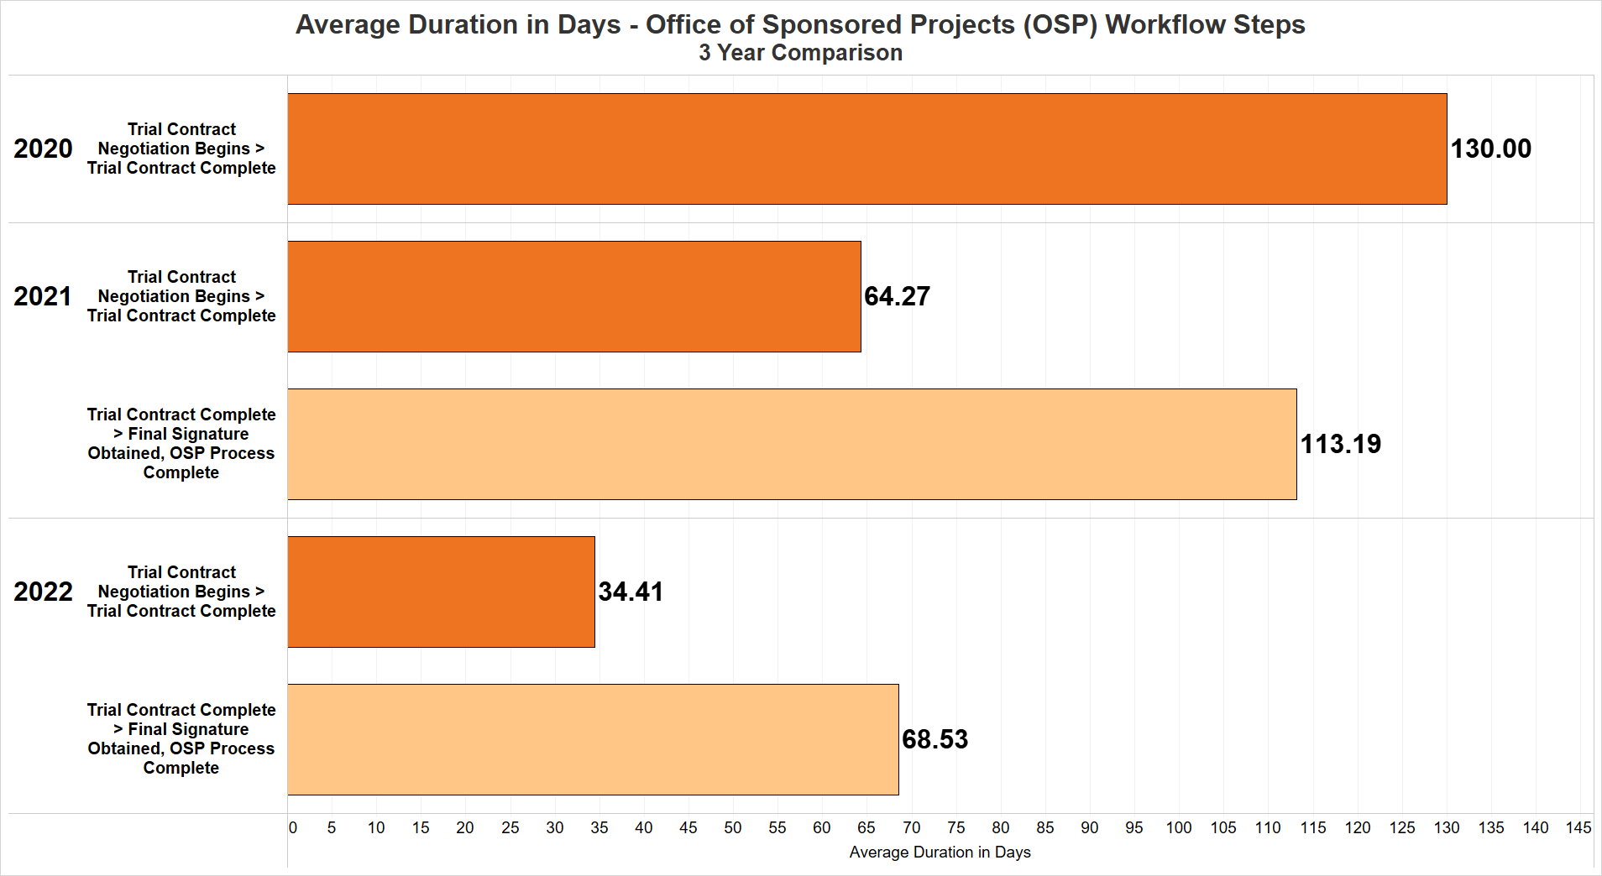
Notes:
Final signature obtained (budget, regulatory approvals)
Efforts have been made to reduce the duration time for both CTA completion and CTA finalization.
2021: average 64.27 days
2022: average 34.41 days

Slide 26
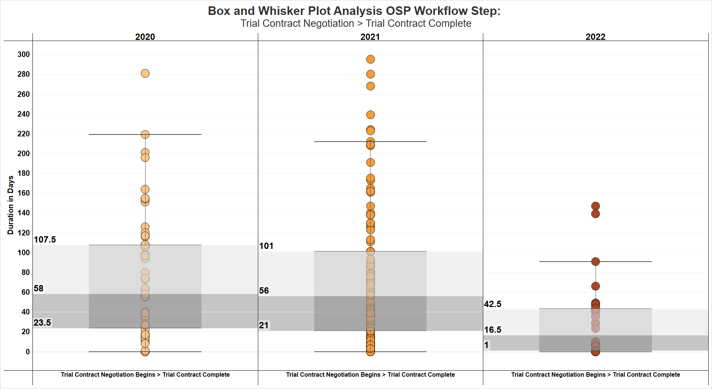
Notes:
Our goal is to continue to reduce turnaround times for negotiation, not at the expense of good/compliant contract language, but to reduce the number of outliers that are longer than the average, and in 2022, we have been doing that.

Slide 27
OSP Clinical Trials Team Initiatives
Solidify Team Structure
Expand Resources
Increase Transparency
Visible Presence
Assess Performance

Slide 28




Visible Presence
Monthly/Quarterly meetings with individual departments to discuss negotiation updates/issues
One click away: Effective use of Zoom and Microsoft Teams
Participation in Research Education courses

Slide 29
OSP Clinical Trials Team Initiatives
Solidify Team Structure
Expand Resources
Increase Transparency
Visible Presence
Assess Performance

Slide 30
Questions
Kevin Peterson, JD, CRA
Associate Director, Clinical Research
Office of Sponsored Projects
kevin.peterson@osp.utah.edu

