Slide 1
Ombuds Services at the University of Utah

Slide 2
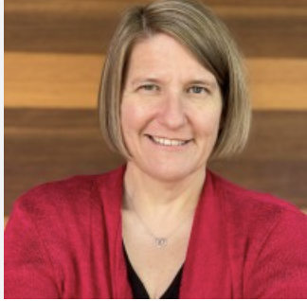
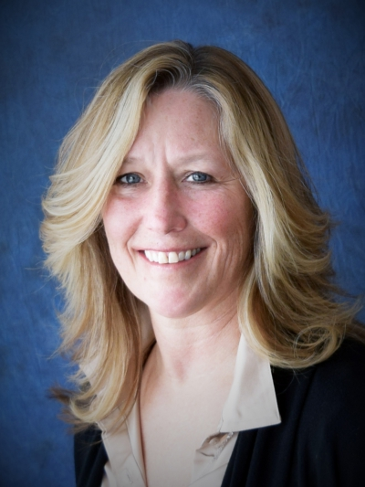
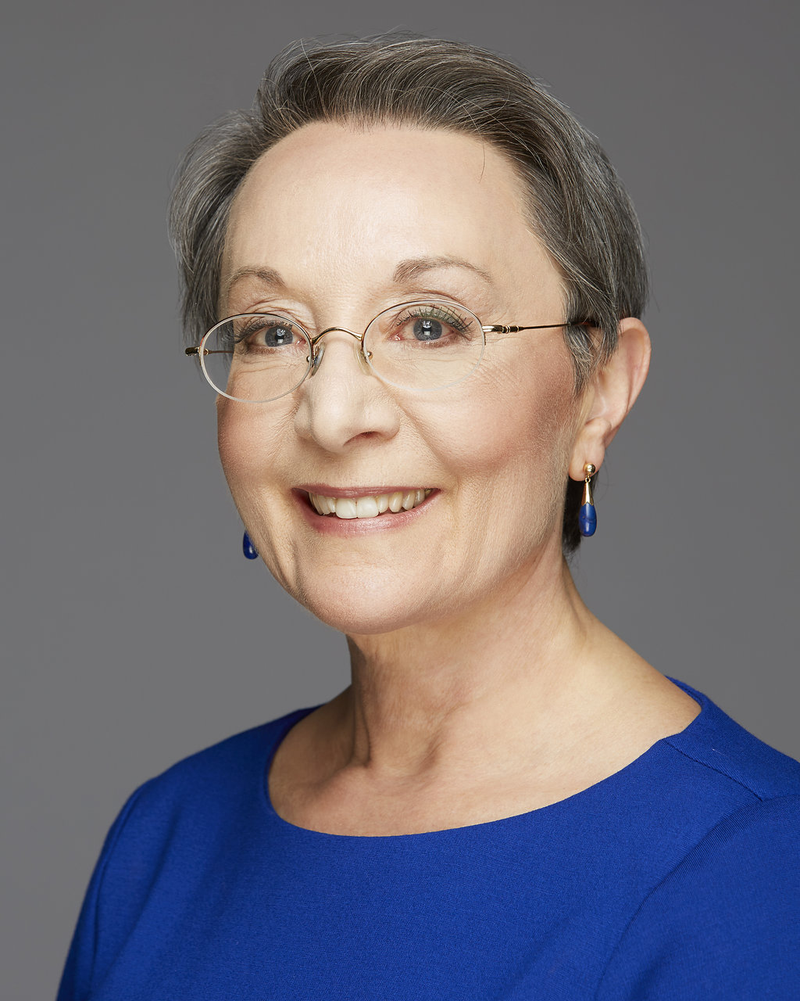
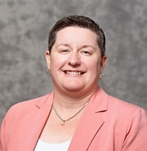
Who we are
Karen Gunning
Maureen Murtaugh
Patricia Kerig
Trina Rich
https://www.ombuds.utah.edu

Slide 3
Training/qualifications
International Ombuds Association Foundations training (1 week)
Mediation training (40 hr course) or Conflict coaching (12 hr course)

Slide 4
International Ombuds Association Principles
Confidentiality
Independence
Neutrality
Informality

Slide 5
Confidentiality
Exceptions
If anyone is at risk
If we are required by law to disclose information
  Clery Act: if someone has been a victim of serious crime on University property

Slide 6
Independence
No formal written records
No formal investigations
No role in formal grievance, complaint, appeal, or legal proceeding
No oral or written testimony

Slide 7
Neutrality
Impartial
  We do not advocate for either side in a conflict
  We do advocate for fair treatment of all

Slide 8
Informality
Goal is to resolve issues without litigation or formal investigation
Speaking with us does not constitute a formal notice to the University

Slide 9
What Ombuds do
Request specific information to clarify a situation
Facilitate a discussion to help resolve a conflict
Work with other leaders to develop an effective approach to a problem
Report systemic issues to University officials

Slide 10
Services
Informal assessment of problems
Coaching on conflict resolution
Facilitation of group discussions
Informal mediation to resolve disputes
Referral to other campus resources

Slide 11
Ombuds will
Serve as a sounding board and discuss concerns confidentially
Provide relevant information including policies and procedures
Assist in developing possible solutions
Help identify options and resources

Slide 12
Ombuds won’t
Keep records
Disclose confidential information
Participate in formal proceedings
Talking with us does not mean you are notifying the UofU about your concerns

Slide 13
Matters you can bring to us
Job conflicts
Problem with advisors
Tenure and promotion issues
Disciplinary matters
Performance appraisals
Salary concerns
Benefits questions
Grading conflicts
Health and safety concerns
Discrimination
Sexual harassment
Authorship disputes

Slide 14
Meeting formats
Phone
Zoom
In-person – location determined mutually

Slide 15
Who are our visitors
Current employees and students of the UofU and UHealth, including:
  Faculty
    Tenure-line, Career-line, Adjunct, and Visiting
  Staff
  Trainees and postdoctoral fellows
  Students
    Graduate, undergraduate
Not sure? Reach out!

Slide 16
Who we can’t visit with
Former employees, faculty, or students
General public
Family members of employees

Slide 17
Contact us
Email: ombuds@utah.edu
Website: https://www.ombuds.utah.edu
Visit request form: https://redcap01.brisc.utah.edu/ccts/redcap/surveys/?s=NA8XKKK3XHD49APD

