Slide 1
What is truth? Misinformation research in the new media environment
Research Quality Compliance Network (RQCN)
Echo L. Warner, PhD, MPH
University of Utah
College of Nursing & Huntsman Cancer Institute
July 16, 2024

Slide 2
Disclosures
Funded by Merck for HPV vaccine misinformation research

Slide 3
Outline
Origin of misinformation
Health misinformation
Mitigation of health misinformation online
Case study: Cancer misinformation
Future steps

Slide 4
Origin of misinformation

Slide 5
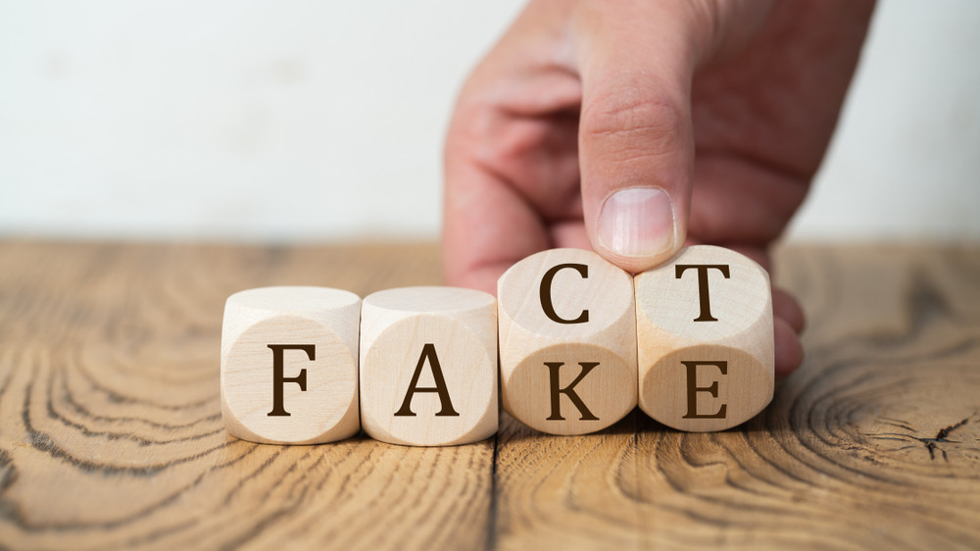
“The use of propaganda is ancient, but never before has there been the technology to so effectively disseminate it”.
Natalie Nougayrède, Guardian columnist
Notes:
Noo—gay-hide

Slide 6
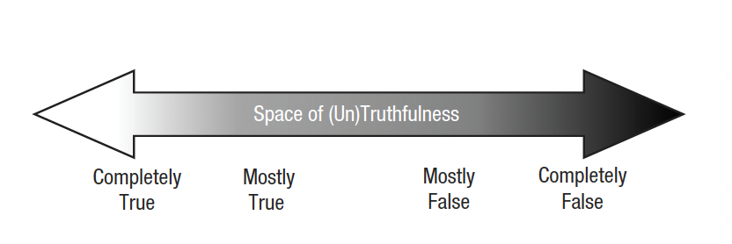
Propaganda
Disinformation
Misinformation
Adams, 2023

Slide 7
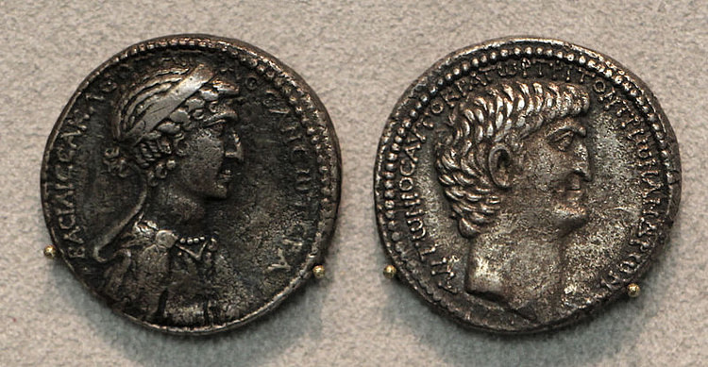
Politics, Marketing, Journalism
History of Propaganda, Misinformation, Disinformation
45 BC – Octavian & Mark Antony smear campaign
1400s – Printing press
1900s – One to many communication
radio, newspaper, TV, satire
2000s – Many to many communication
social media, internet
2020s – “Computational propaganda”
trust & truth become subjective
2024 – “Information disorder”, “fake news”
”media environment”, ”troll armies”, AI

Slide 8
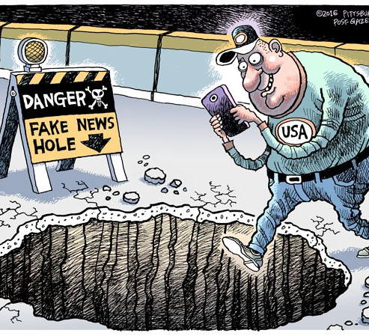
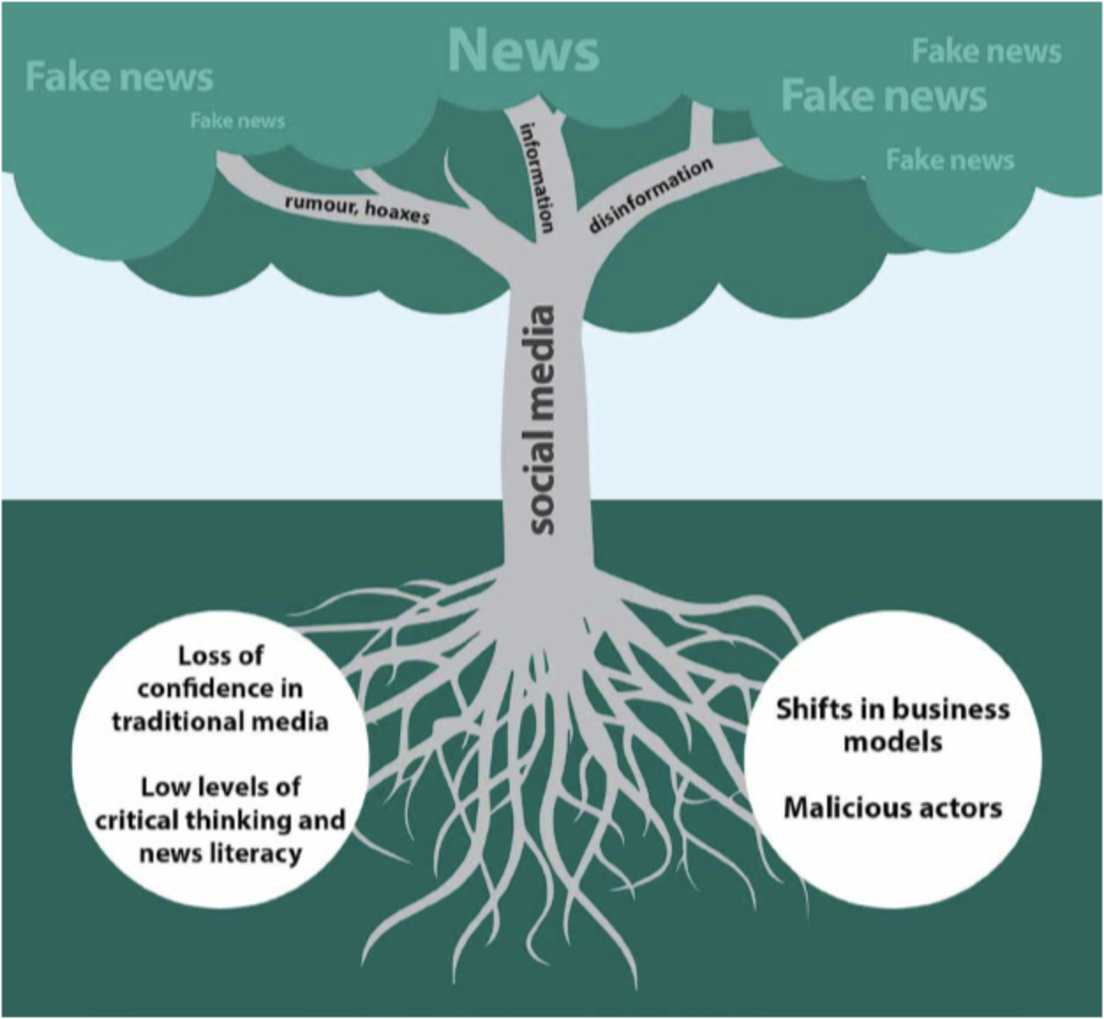
Age of technology
Notes:
https://www.linkedin.com/pulse/rubbish-heap-history-fake-news-fiasco-practical-frivolous-theo-budgen/

Slide 9
Intersubjectivity
“Go it alone”
“A coordinat[ed] effort between two or more people to interpret entities in the world (ideas, events, people, observations) through social interaction.”
- Adams 2023
Notes:
Advanced technology and communication means that our way of knowing is undergoing a paradigm shift from a reliance on ground truths to social interaction

Slide 10
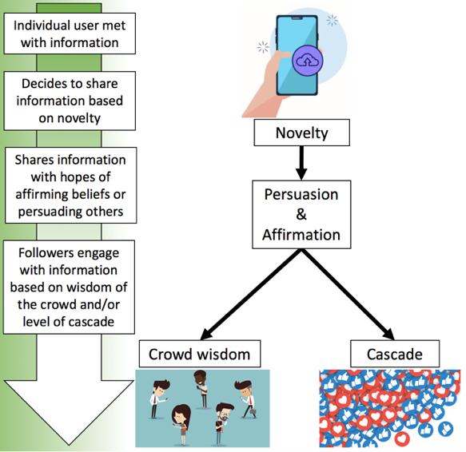
Theory of misinformation spread
Misinformation spreads more broadly, quickly, and is more penetrable than accurate information
(Hsu, 2019)

Slide 11
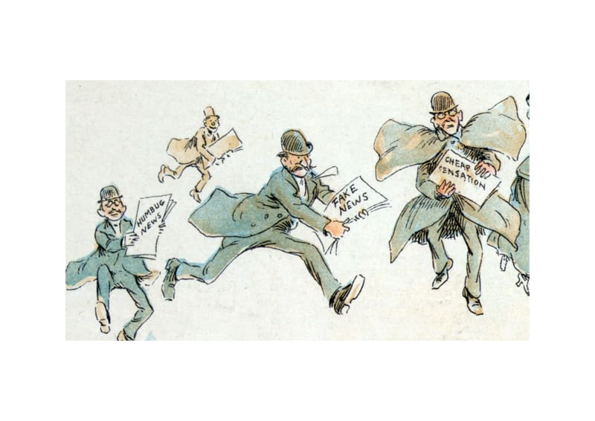
Curation & mediation focus on credibility vs. standard for publication/amplification is interest, excitement, clicks
Proliferation of information ≠ proliferation of truth
Professional responsibility to truth, credibility, and fact checking
https://www.peoplematters.in/site/interstitial?return_to=%2Farticle%2Flife-at-work%2Fthe-impact-of-fake-news-on-workforce-your-organization-17231

Slide 12
Health misinformation

Slide 13
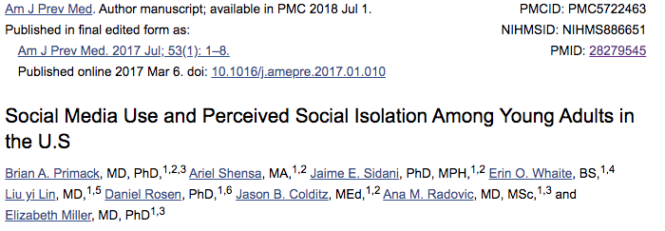
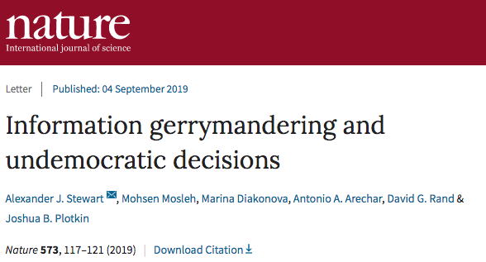

Slide 14
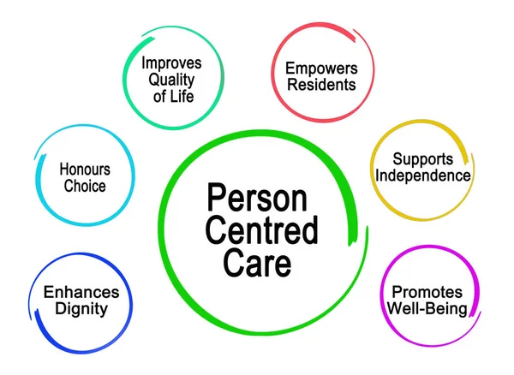
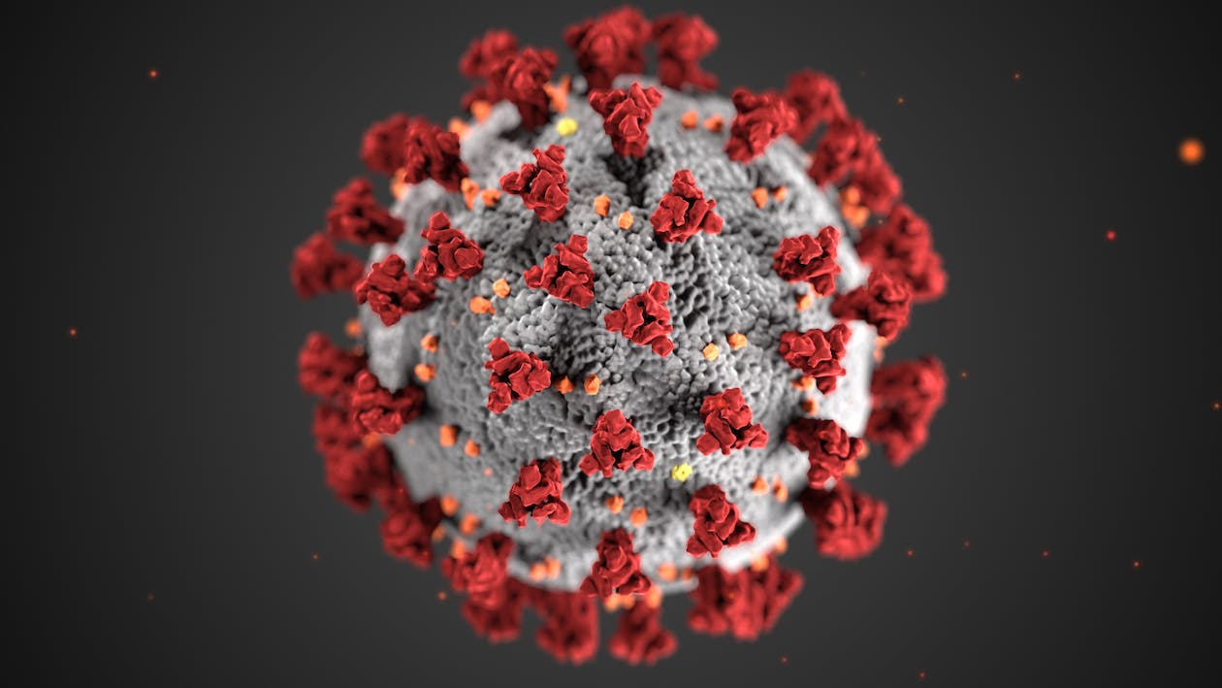
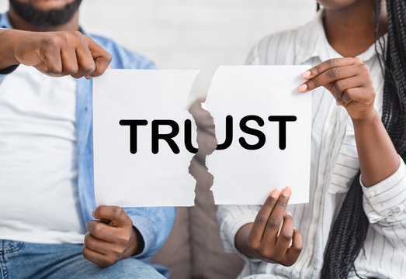
Paradigm shifts
Notes:
Patient centered care
COVID-19
Credibility & mistrust

Slide 15
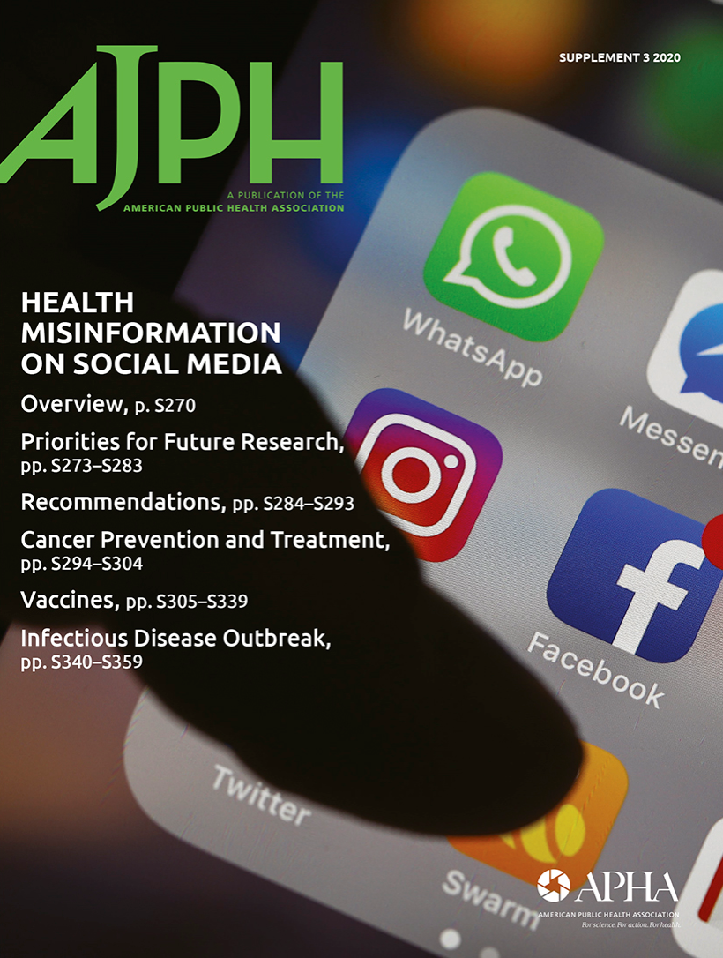
Health Misinformation
“False, inaccurate, or incomplete information, rumors, ineffective alternative therapies, skepticism about medical guidelines, and misleading or untrue health-related advice.”

Slide 16
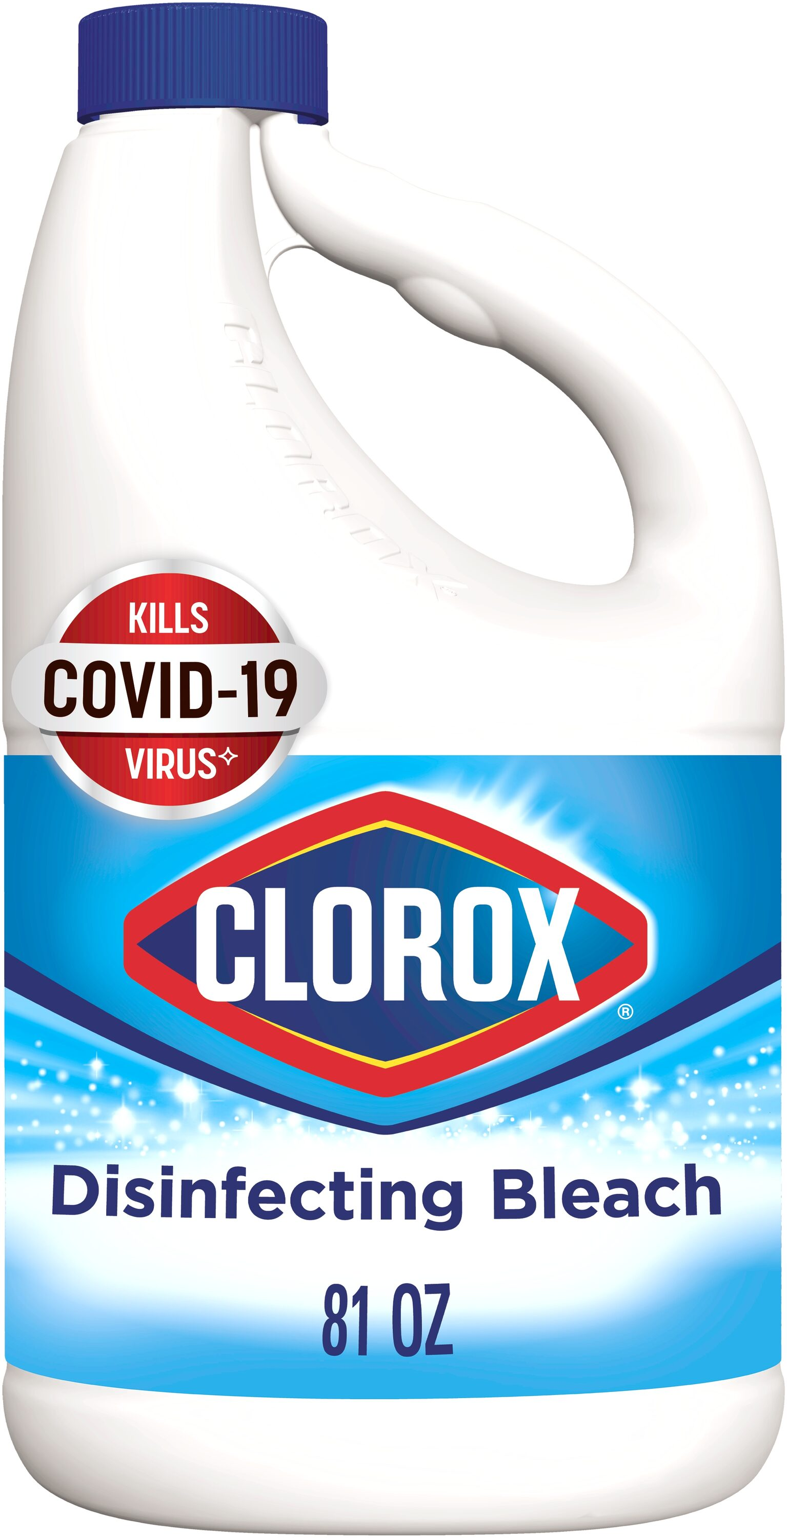
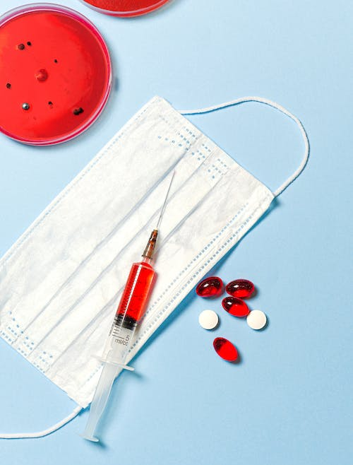
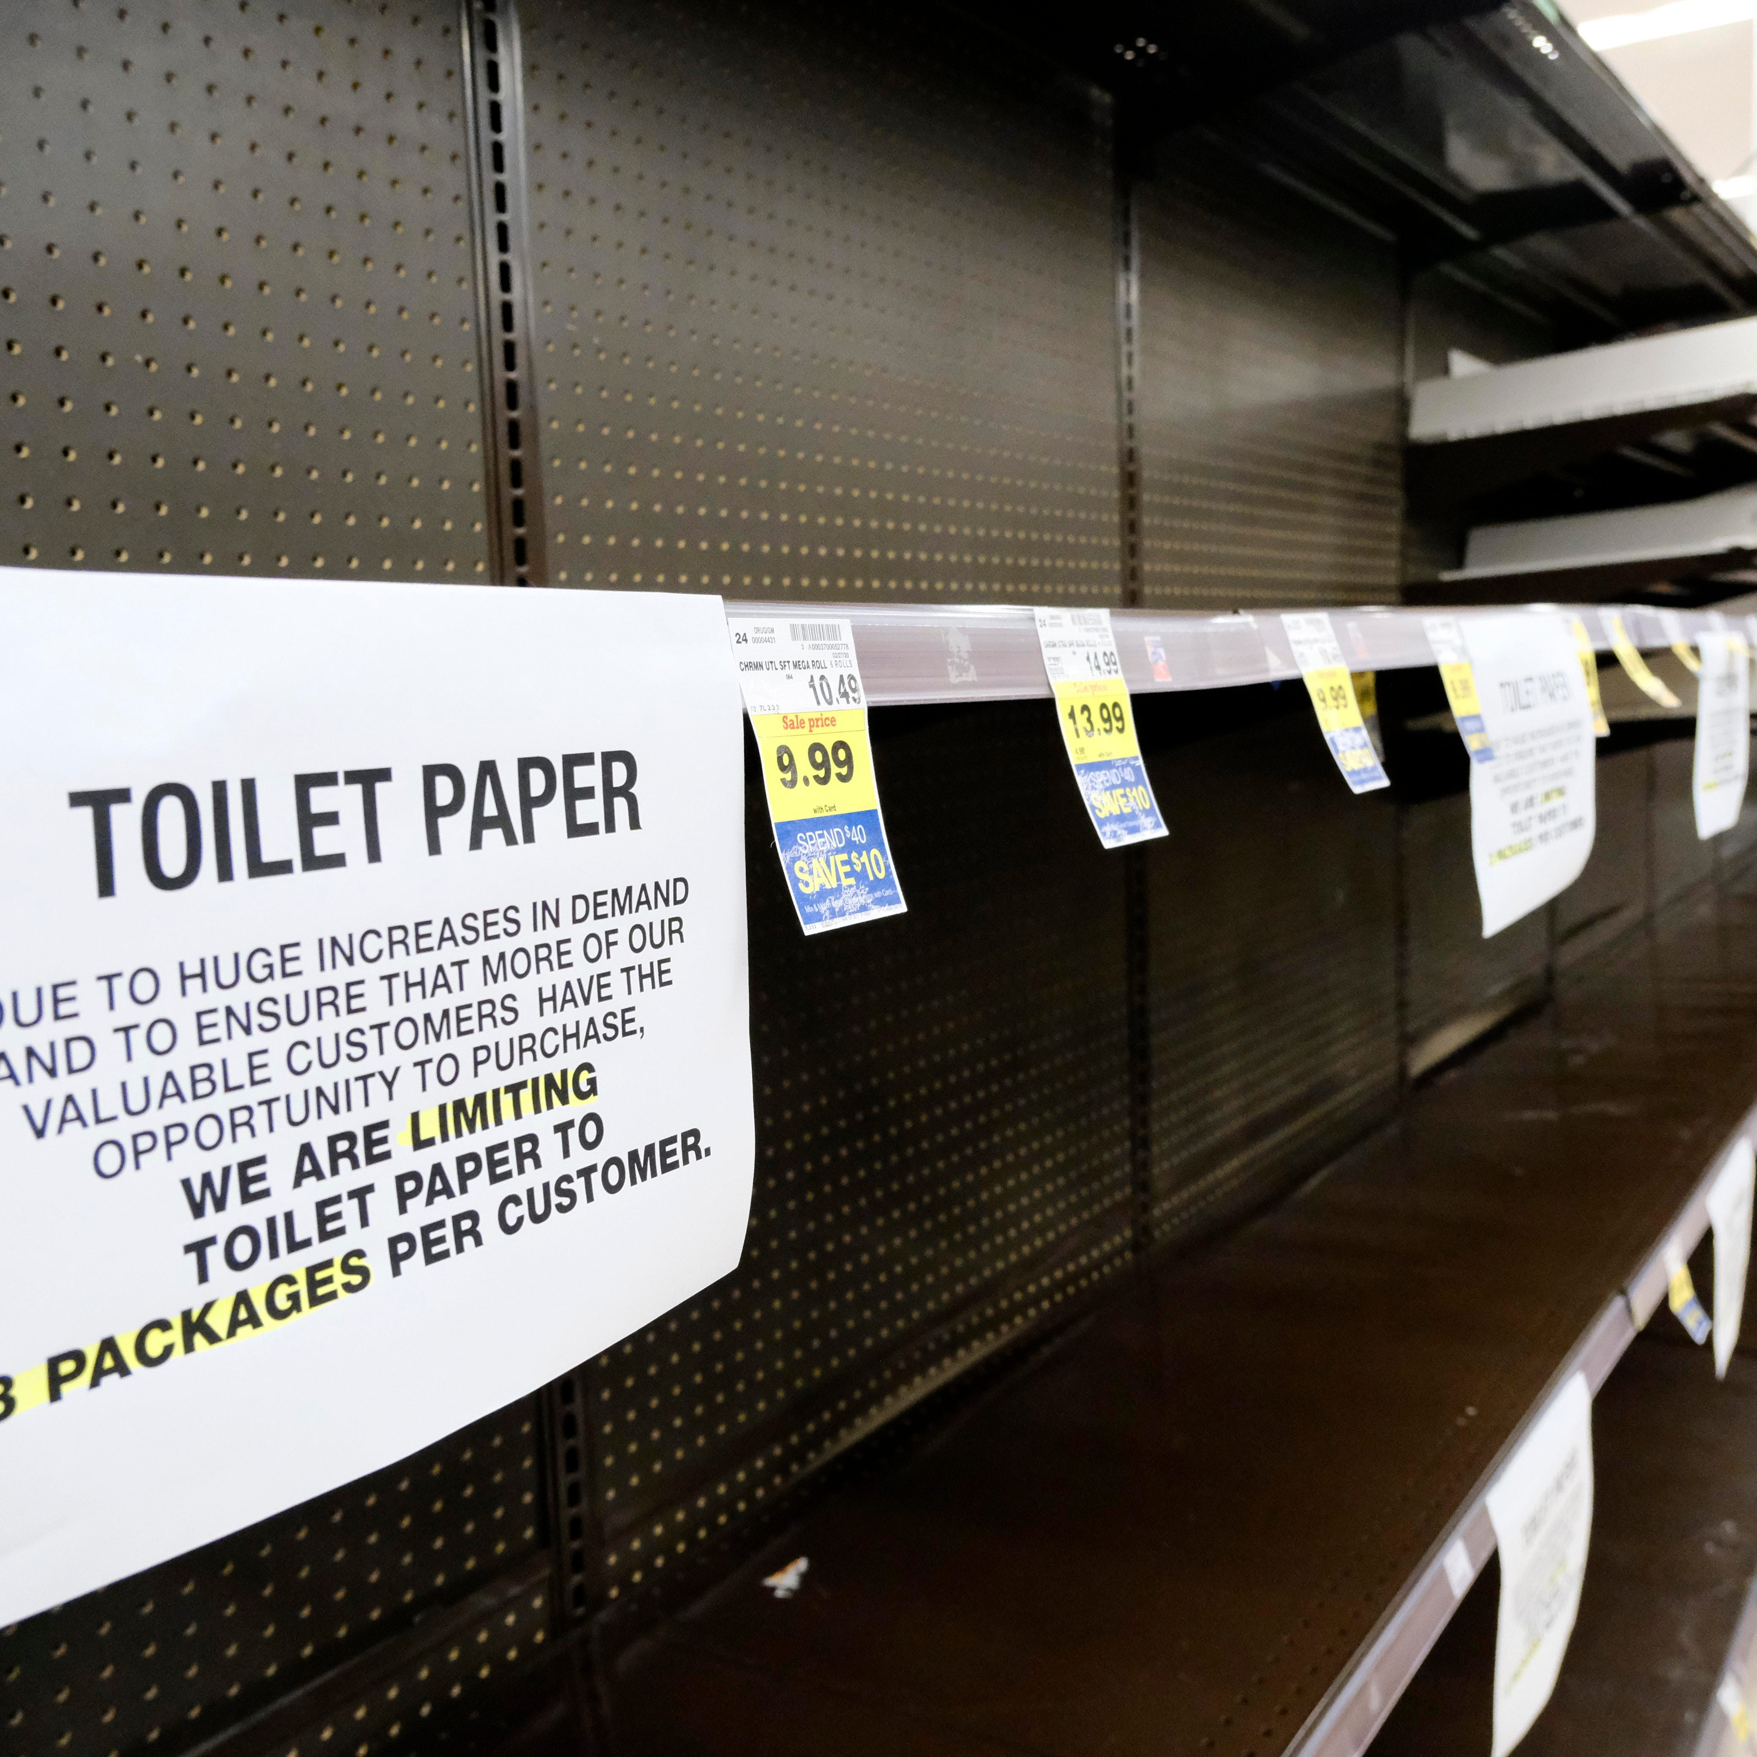
Proliferation of health misinformation

Slide 17
Effects of misinformation
Individual
Cognitive, behavioral, beliefs/attitudes, intentions
Societal
Media, politics, science, economics
Adams, 2023

Slide 18
Beliefs
Causal pathway?
Misinformation
Aberrant behavior
Lack of empirical evidence
Complex belief generation
Complexity of beliefs and behavior
Adams, 2023

Slide 19
Common themes across studies
Authority figure/stance
Insider information
Varying levels of perniciousness
Varying levels of impact on behaviors
Southwell, 2020

Slide 20
Current & Future Research Steps
Examine potential & strength of beliefs (i.e., prevalence)
Role in behaviors and actions on a societal level
Best tools and strategies for accessing the problem
Adams, 2023
Notes:
Measuring exposure to misinformation (COMET)
Outcomes in cancer disparities (ECHO Study & C3)
Measure development cancer misinformation (SMILE Study)
Social media interventions to mitigate cancer misinformation and promote high quality cancer information (#4Corners4Health, XXX)

Slide 21
Where does morality stand?
Objectivity means giving all sides equal hearing and talking to all sides
But not treating all sides equally
Not creating a forced moral or factual equivalence
https://www.ted.com/talks/christiane_amanpour_how_to_seek_truth_in_the_era_of_fake_news

Slide 22
Mitigation of health misinformation

Slide 23
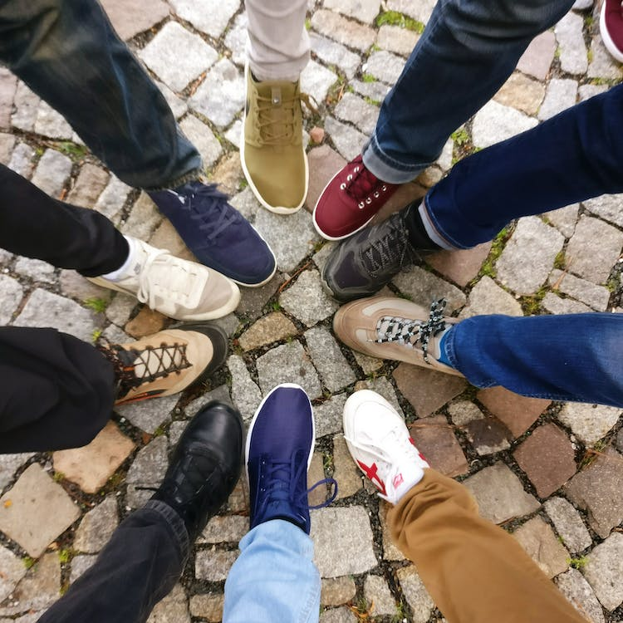
Recommendations – Healthcare
Engage with patients about misinformation
Meet the public where they are (online!)
Use online tech to disseminate accurate info
Local partnerships
Confronting Health Misinformation, 2021 US Surgeon General Report

Slide 24
Recommendations – Research
Improve monitoring systems for tracking misinformation
Examine exposure and impact
Efficacy of mitigation
Debunking vs. prebunking
Confronting Health Misinformation, 2021 US Surgeon General Report

Slide 25
Recommendations – Tech & Gov
Redesign algorithms to reduce virality
Detect super-spreaders, bots
Proactively address misinformation
Prioritize trusted messages/sources
Invest in misinformation research and education
Increase resources, funding, and tech support for public heath agencies
Confronting Health Misinformation, 2021 US Surgeon General Report

Slide 26
Case study: Cancer misinformation

Slide 27
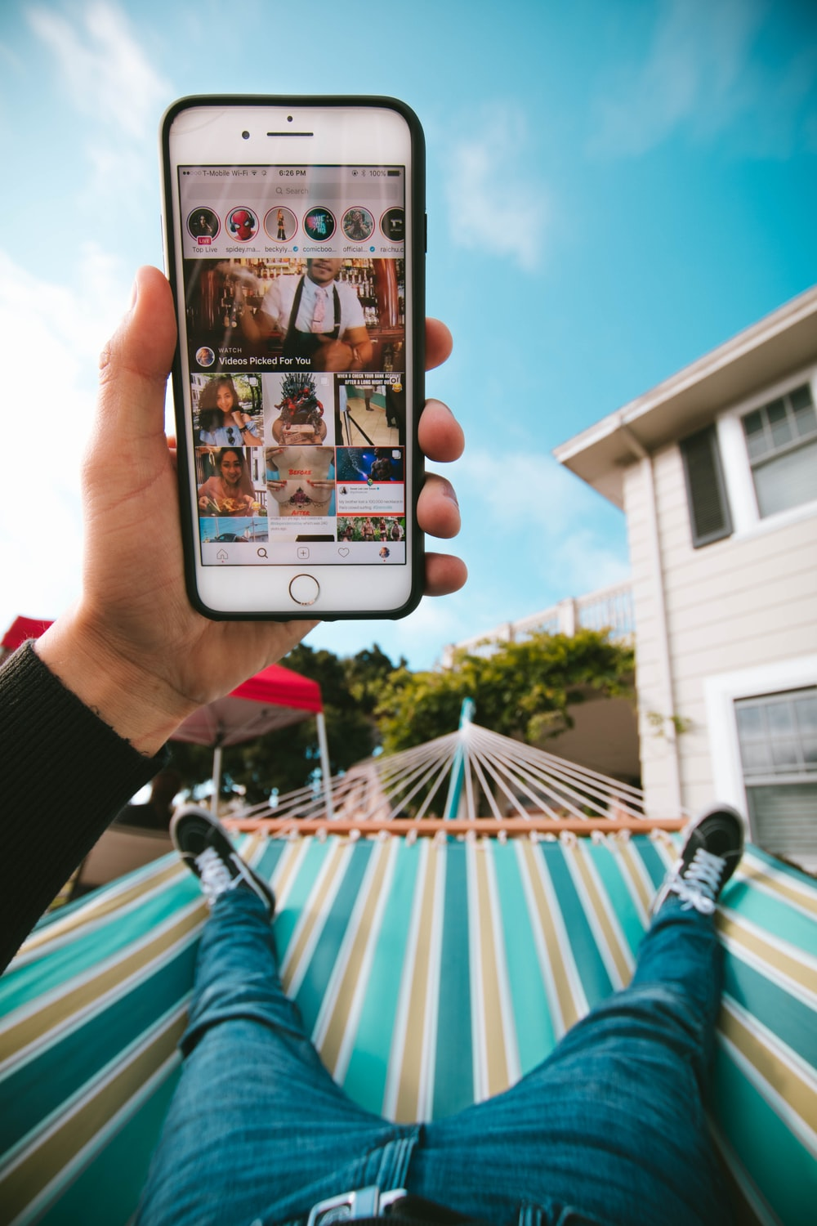
Social Support in Online Communities
Caregivers who post about cancer on social media get support they otherwise would not
Warner, Psycho-oncology 2020
Notes:
The main reason young adult cancer caregivers used social media was because it was easier for providing updates about the cancer patient compared to other methods. Caregivers liked how using social media saved them time compared to more traditional methods like phone calls, emails, or text messaging their loved ones to tell them about the cancer patient. However, they felt it was essential to discuss social media posts with the cancer patient before any posts were made public as some patients did not want their cancer diagnosis posted about online. Caregivers who did post online about the cancer diagnosis and experience felt doing so was less emotionally burdensome way of updating their social network than having to re-tell the situation over and over when they saw people face to face.

Slide 28
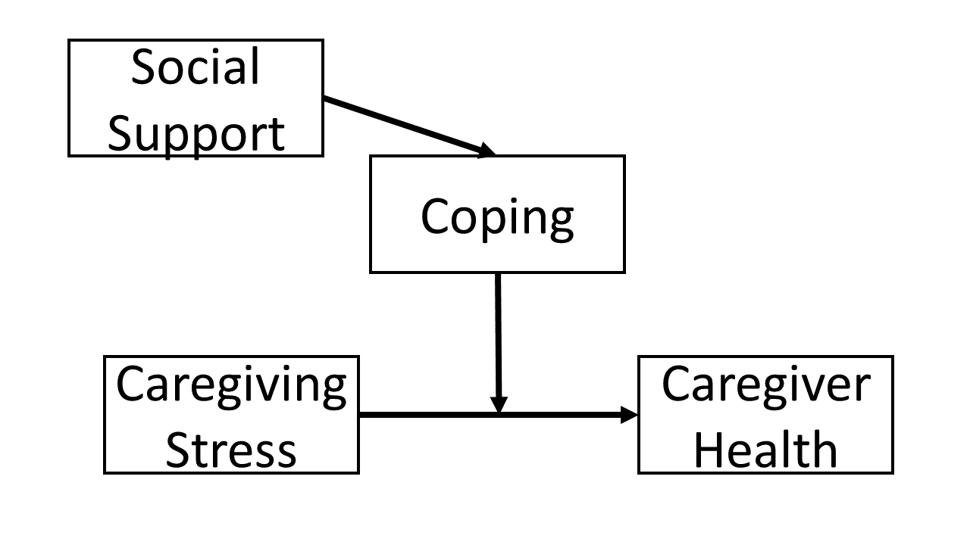
Stress & Coping Social Support Theory
Lazarus, 1984
Functional social support definitions and social media examples
Emotional | Sympathy, caring, acceptance | Comments including: “You are amazing!” “Our hearts are with you”
Instrumental | Transportation, household chores, child care, finance | Links to scholarships, fundraising. Posts seeking childcare, transportation.
Information | Knowledge, information, advice, alternative action | Links to articles/videos related to caregiving or cancer questions.
Companionship | Availability of persons to spend time with | Links to YACC support groups, chats, or events. Posts planning activities with others.
Validation | Feedback, social comparison | Comments such as “My mother was diagnosed with breast cancer, too”.

Slide 29
Posting about cancer online presents opportunities for negative consequences
Warner, Psychooncology 2020
Notes:
There was broad acknowledgement from caregivers who posted about their cancer experience and those who did not that posting about cancer online presents opportunities for negative consequences, including misinformation or bad advice, uncomfortable responses like criticism or insincerity, and the lack of social cues was a challenge for some caregivers because being physically separated made it difficult to understand responses and hard to know how to respond to others
uneven comparisons
unsolicited advice
minimized the caregiver’s experience
insincere comments
incongruent support

Slide 30
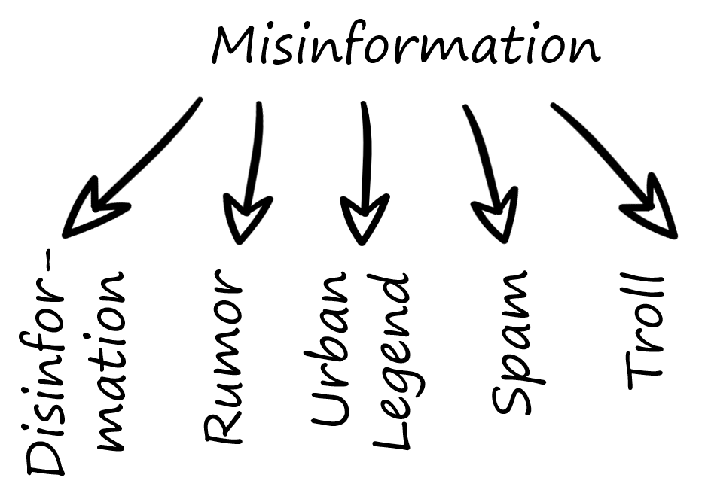
Young Cancer Caregiver Misinformation
.
Warner, Cancer 2020; Mollica, Cancer 2020
Notes:
Caregivers were exposed to a variety of cancer misinformation topics; some felt uncertain in their caregiving ability when confronted with cancer misinformation
Caregivers crosschecked online sources and consulted trusted individuals (e.g., family, friends, healthcare providers) to determine quality of cancer-related information and manage cancer misinformation.

Slide 31
Misinformation among young patients & caregivers
Unmet information needs
Seek information where they are comfortable
May or may not provide accurate information
Potentially vulnerable or resilient to misinformation
Notes:
(e.g., lack of experience with severe illness, limited health literacy)
(e.g., digital natives)

Slide 32
Why exposure happens?
Satisfy unmet information needs
Anecdotal health information
Information that is uncomfortable to discuss with providers
Cancer information is vastly unregulated
User-generated sites (e.g., social media, forums)
Financial incentives, cancer patients are vulnerable

Slide 33
Consequences of exposure
Patient and caregiver beliefs & decision making
Treatment & Medication Adherence
Health & Financial outcomes
Addressing misinformation may increase survival by more than 5-fold among certain cancers
470% increased risk of death if cancer patients forego evidence-based strategies in favor of unproven treatments
30-40% of social media articles have harmful misinformation for patients
Reduce financial hardship
Gage-Bouchard 2018, Johnson 2018, Johnson 2018, Johnson 2021

Slide 34
What we’ve found about misinformation in health…
Affects relationships, finances, and mental wellbeing
Broader reach/penetration than true information
Dissemination driven by $$$ & politics
Vaccine misinformation is particularly pernicious, conspiratorial
Cancer misinformation emphasizes nutrition
Warner, 2020, 21, 22, 23

Slide 35
Many sites make specific food and nutrient claims
 | Academic citation |  | No Academic citation
 | N | % | N | % | p-value
Foods | 24 | 88.9 | 46 | 58.2 | <0.01
Micronutrients | 24 | 88.9 | 39 | 49.4 | <0.01
Anti-oxidants | 18 | 66.7 | 25 | 41.6 | <0.01
Anti-inflammatory | 18 | 66.7 | 15 | 19.0 | <0.01
Digestion | 18 | 66.7 | 16 | 20.2 | <0.01
Herbs | 17 | 63.0 | 25 | 41.6 | <0.01
Sugar | 9 | 33.3 | 11 | 13.9 | 0.03

Slide 36
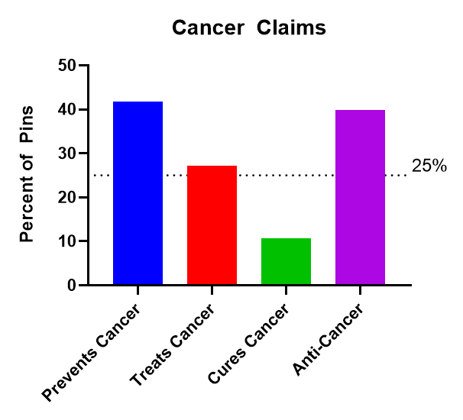
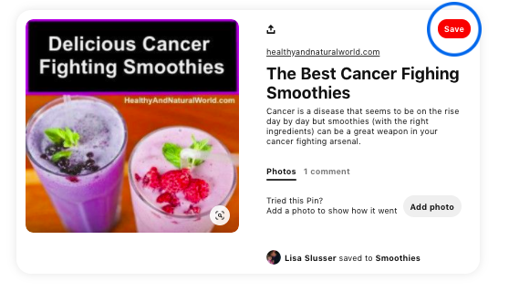
Claims of preventing or treating cancer are not uncommon. Buzz words are commonly used “anti-cancer”, “cancer-fighting”, “cancer cell killing”
 | Academic citation |  | No Academic citation
 | N | % | N | % | p-value
Prevents cancer | 21 | 77.8 | 24 | 30.4 | <0.01
Anti-Cancer | 16 | 59.3 | 26 | 32.9 | 0.02
Treats cancer | 14 | 51.8 | 15 | 19.0 | <0.01

Slide 37
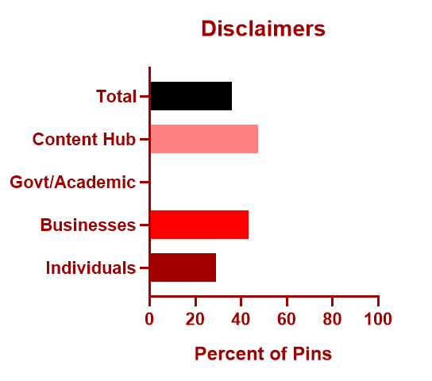
Disclaimers are not universal, less than half of sites have them

Slide 38
CIRCLE Study - Advice
Adding filters/warnings to sensitive or inaccurate info
Option to mute ads/pages related to cancer
Virtual education about misinformation
Virtual provider recommendations for high quality cancer content

Slide 39
CIRCLE Study - Conclusions
If they felt it was safe, participants acted upon information of questionable legitimacy from social media.
Negative cancer interactions prompted them to leave online support communities and led to relationship changes with their social networks.

Slide 40
Future steps

Slide 41
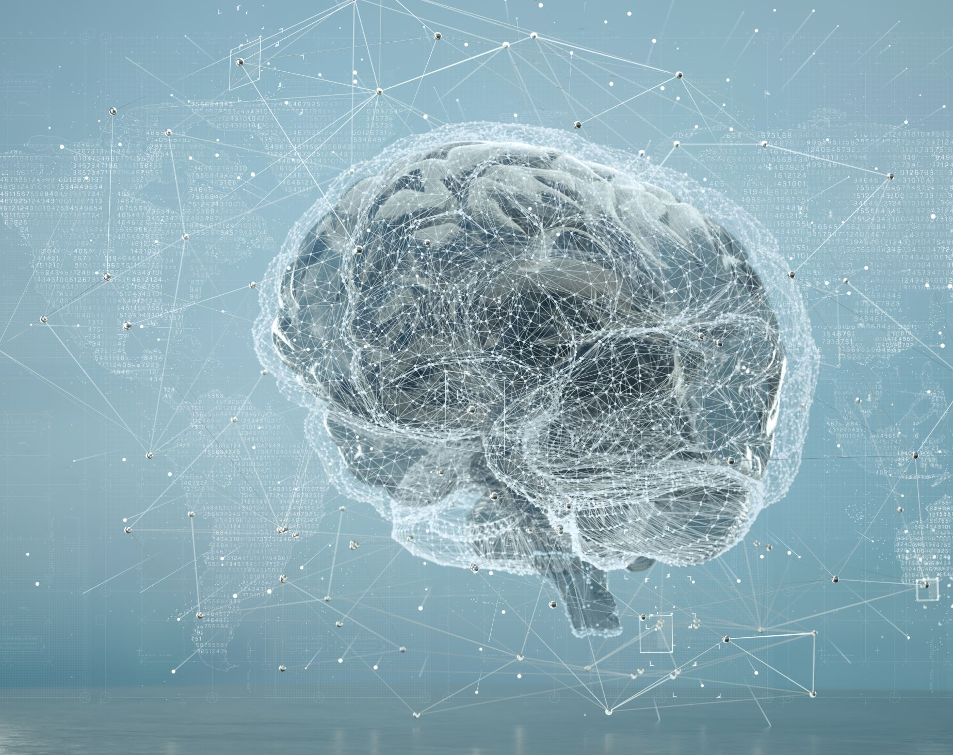
Artificial intelligence
Hallucinations
Social influence & credibility indicators

Slide 42
What role does AI play?
Sophisticated and scalable dissemination
Automated content generation
Amplification, personalized targeting
Manipulation of media
Bot networks
Echo chambers
Impersonation and identity theft
Notes:
Automated Content Generation: AI can create text, images, and videos that mimic human-generated content, making it difficult to discern between genuine and fake information.
Amplification and Targeting: AI algorithms can amplify misleading content by targeting specific demographics based on their preferences and behaviors, maximizing its reach and impact.
Manipulation of Media: AI can be used to alter images and videos convincingly, creating deepfakes that mislead viewers into believing false information.
Bot Networks: AI-powered bots can automate the dissemination of misinformation on social media platforms, influencing public opinion and trending topics.
Echo Chamber Effect: AI algorithms can reinforce existing biases by presenting users with content that aligns with their beliefs, potentially leading to the spread of misinformation within homogeneous groups.
Impersonation and Identity Theft: AI can mimic voices and writing styles, enabling impersonation of trusted figures or organizations to spread false information.

Slide 43
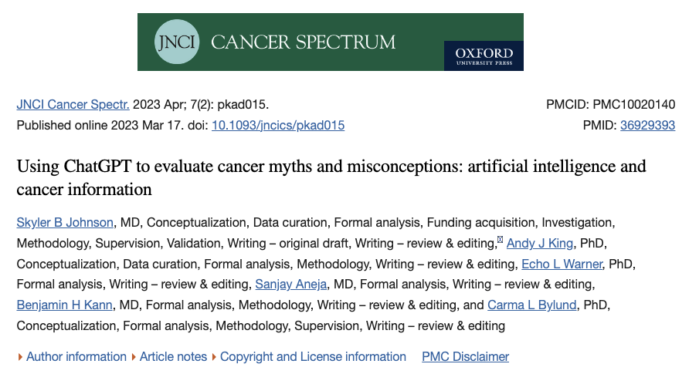

Slide 44
What can I do?
As social network members…
Cite credible information & link to experts
Offer alternative explanations
Reinforce through repetition
Be open-minded, accepting, and timely in response
Foster expectations of fact checking
As scientists….
Careful dissemination
Partner with influencers
Be a critical early adopter
In research…
Discuss strategies of misinformation curators & their financial incentives
Recommend high quality, self-led information sources
Refer to high quality community resources
Warner & Johnson, 2023; Utz & Warner, 2022

Slide 45
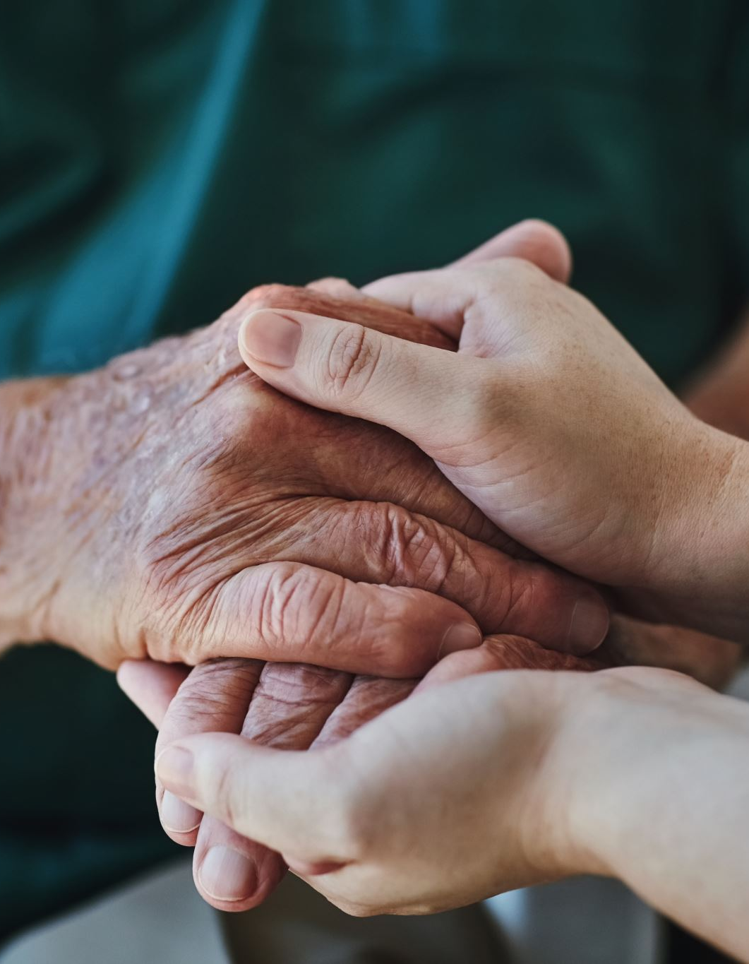
Implications for research compliance
Unanticipated misinformation/disinformation
Inadvertent breaches of confidentiality
Financial threats & incentives
Address institutional credibility & trustworthiness
Revisit the power of stories & social connection
Southwell, 2020

Slide 46
Current & Future Regulation
Moral obligation to TRUTH
Regulation emphasizing empowerment
Freedom of speech & harm principle
Adams, 2023
Notes:
Measuring exposure to misinformation (COMET)
Outcomes in cancer disparities (ECHO Study & C3)
Measure development cancer misinformation (SMILE Study)
Social media interventions to mitigate cancer misinformation and promote high quality cancer information (#4Corners4Health, XXX)

Slide 47
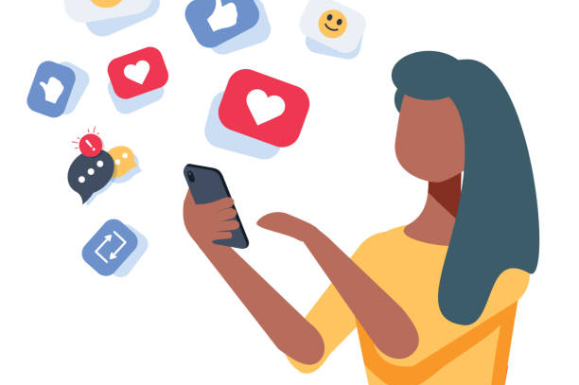
Take home…

Slide 48
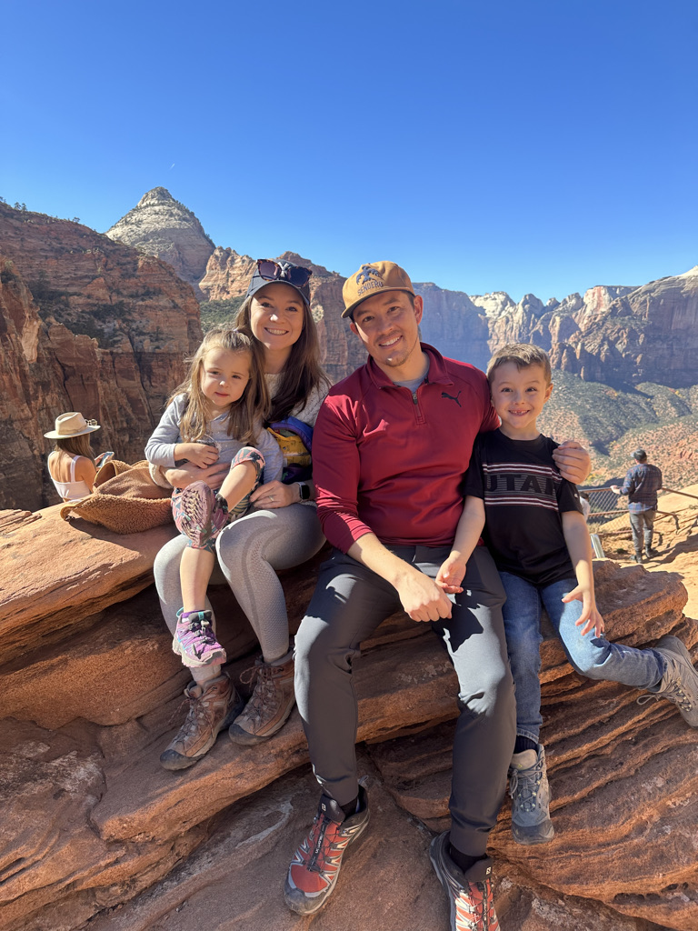
Thank you!
Collaborators & Mentors
Drs. Anne Kirchhoff, Deanna Kepka, Lee Ellington, Kristin Cloyes, Ye Sun, Andrew Wilson Terry Badger, Gondy Leroy, Stephen Rains, Robin Harris, Margaret Raber, Skyler Johnson, Andy King
Warner Team & Mentees
Austin Waters, Jennifer Traslavina Jiminez, Ashley Green, Keely Smith, Sara Bybee, Cindy Turner, Ida Tovar, Caleb Hocutt, Dr. Mary Killea
Funding & Support
NCI F31CA221000, NCI T32CA078447, American Cancer Society, Sursum Fellowship University of Arizona, University of Arizona College of Nursing’s Bauwen’s Research Award, Jonas Foundation for Nursing and Veteran’s Healthcare
Contact me: echo.warner@nurs.Utah.edu
801-244-7040| @WarnerEcho
Notes:
So my vision for the future is to adapting the technology used in SM platforms like FB and Twitter to break down physical and geographic barriers to social support for YACC. So that no matter how far apart they may be physically the two YACC I mentioned at the beginning of my talk would be able to use SM to connect and support one another.

Slide 49
Online misinformation exposure
Automated tracking of cancer information exposure
Codebook applied to classify misinformation
Software applications for measurement and classification of misinformation
Refinement of conceptual framework
Disparities in misinformation’s impact among SGM

Slide 50
References
chrome-extension://efaidnbmnnnibpcajpcglclefindmkaj/https://www.icfj.org/sites/default/files/2018-07/A%20Short%20Guide%20to%20History%20of%20Fake%20News%20and%20Disinformation_ICFJ%20Final.pdf
https://misinforeview.hks.harvard.edu/article/critical-disinformation-studies-history-power-and-politics/
https://cits.ucsb.edu/fake-news/brief-history

