Slide 1
Investigational Drug Service (IDS): Overview
Camryn Froerer, PharmD, MS, BCPS
Jacob Majers, PharmD, BCPS

Slide 2
Objectives
General overview of IDS processes
What a pharmacy binder looks like
Best practices or tips for working with IDS
Importance of notifying IDS of protocol revisions
Exemption requests

Slide 3
General overview

Slide 4
IDS Staff / Hours
Hours: 7 am to 5:30 pm
Located at the Huntsman Cancer Hospital, Suite 2545
Pharmacists
Camryn Froerer, PharmD, MS, BCPS (manager)
Berrie Child, PharmD, BCOP
Kristie Holbrook, PharmD
Jacob Majers, PharmD, BCPS
Winter Redd, PharmD
Michael Voight, PharmD
Cameron Hill, PharmD, PhD
Paymon Mirzaakbari, PharmD
Ashley Hedges, PharmD, BCCPS, BCPS
Rachael Freeman, PharmD, BCPS
Pharmacy Technicians
Cody Nesbit, CPhT
Michelle Hillman, CPhT
Brittney Scharman, CPhT
Jason Worthen, CPhT
Whitney Crosgrove, CPhT
Austin Jett, CPhT
Camille Hutchins, CPhT
Alan Perez, CPhT
Notes:
Cam

Slide 5
Mission – University of Utah Health
We provide compassionate care without compromise.
We educate scientists and health care professionals for the future.
We engage in research to advance knowledge and well-being.
Notes:
Cam

Slide 6
Study Growth
Notes:
Jake

Slide 7
Who We Serve
Study patients
Principle Investigators (PIs) and their study team and other MD/DOs
Clinical and Translational Science Institute (CTSI) (located in Research Park and Neuro Acute Care (NAC))
Study sponsors (monitors)
Other pharmacists
South Jordan (satellite site)
Farmington (satellite site)
Sugarhouse (satellite site)
Floor / clinic
Nurses
Infusion rooms
Floor / unit-based
Notes:
Jake

Slide 8
Types of Study Sponsors
Pharmaceutical industry-sponsored (eg, GSK, Genentech, Pfizer)
Cooperative groups (eg, ECOG, SWOG, Alliance, ETCTN)
PI-initiated (MDs, residents, fellows, PhD)
NIH-grant funded, other foundations
Notes:
Jake

Slide 9
Purpose of IDS
IDS pharmacy is responsible for the following:
Receipt and storage of study medication
Proper labeling and dispensing
Drug accountability
Proper disposal or destruction
Billing for services related to investigational drugs
Responsible for tasks assigned on “delegation of authority” (DOA) log
This is a regulatory document defining role of study staff
Notes:
Cam

Slide 10
Storage
24/7 temperature monitoring within the pharmacy using Centrak (accessed via Zulafy)
Storage Capabilities
Controlled room temperature (15 to 30°C)
Refrigerated (2 to 8°C)
-20°C Freezer (-25 to -10°C)
-80°C Freezer (-80 to -70°C)
Study drugs are accessible to only pharmacy staff
Pharmacy door serves as 1st lock
Most times, another lockable pharmacy door or lockable cabinet as 2nd lock
Controlled substances (study drugs) are locked in a drug safe (CSM)
Notes:
Cam

Slide 11
Temperature requirements
Room temp:
Controlled room temperature (15 to 30°C)
Many studies require their drugs to be between 15 and 25 degrees
Refrigerated (2 to 8°C)
Frozen
-20°C Freezer (-25 to -10°C)
-80°C Freezer (-80 to -70°C) (usually for viral or gene tx)
We do not monitor the temperature of compounded drug being transported to patient on campus as it is a short walk of transport to those areas
If you would like to store medication outside our pharmacy (ie in an office) until a patient arrives you will need to a thermometer with a min and max temperature settings and log to keep track of daily temp readings for the time IP is stored.
Notes:
Jake

Slide 12
Dispensing
Takes about 2x times longer to dispense
Prescriptions for study medication must have the following:
Standard information
Study protocol name or number
Indication of signed consent
Signature of investigator or co-investigator(s)
Neon pink “Investigational Drug” label or print “Investigational Drug” on the top of the EPIC label on ALL study medications
Handle with caution
USP <800> implementation
Notes:
Jake

Slide 13
Accountability
Vestigo - electronic drug accountability
Documentation - similar to narcotics
Receiving from sponsor
Dispensing to patient
Transfers (to different protocol, another site)
Returns (from patient, to sponsor)
Notes:
Jake

Slide 14
Accountability
Monthly inventory
Check drug count
Check for expiring drug
Not always on the product label
Information sent to IDS manager
All records archived indefinitely in Vestigo
Notes:
Jake

Slide 15
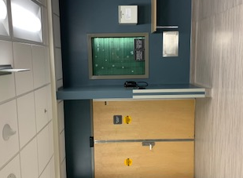
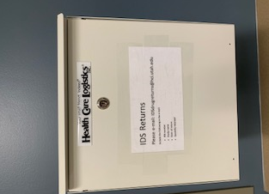
Return of Investigational Meds
UHOSP IDS drug return bin is located toward the north end of the main hallway on the A-level between doors A090 and A050
Notes:
Jake

Slide 16
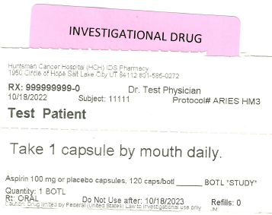
Labeling Investigational Meds
FDA Requirements for outpatient prescriptions:
Pharmacy information
Patient name
Prescriber
Drug name with strength and dose form
Instructions (including route of administration)
Quantity dispensed
Expiration
Date of dispense
Refills
Federal caution statement
Federal law prohibits the transfer of this drug to any person other than the patient for who it was prescribed
Caution, Drug limited by Federal (United States) Law to investigational use only
Notes:
Jake

Slide 17
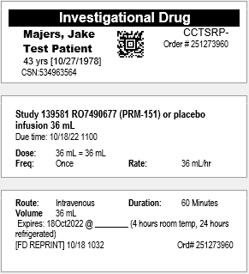
Labeling Investigational Meds
Requirements for inpatient/clinic administered medication:
Drug name with strength and dose form
Expiration date
We include more information than required by law like patient name for increased safety.
We also prefer to utilize Epic for drug administration of all inpatient/clinic administered medication to increase safety and simplify accountability.
Barcode scanning can prevent inadvertent administration errors.
Notes:
Jake

Slide 18
Billing
Patients do not get billed for investigational drugs
IDS determines the costs associated with each study and bills the clinical trials office or PI
Investigators/sponsor are billed for pharmacy-related expenses
Cost estimates prepared ahead of study opening
Notes:
Cam

Slide 19
Study Binders
Notes:
Cam

Slide 20
Electronic Study Binders - Vestigo
Short instructions
Master Subject List
Accountability Logs
Patient-specific information (consent, Rx, randomization)
Shipping/receiving information
Company correspondences
Training competencies
Notes:
Cam

Slide 21
Tips for working with IDS
Notes:
Jake

Slide 22
Working with IDS - Tips
For general requests email Investigational.Pharmacy@hci.utah.edu
A coordinating pharmacy technician monitors our shared inbox and will forward requests to the appropriate audience if you are unsure who a request needs to be sent to
Notes:
Jake

Slide 23
Working with IDS - Tips
Scheduling:
SIVs: SIV Central Scheduler (qualtrics.com))
Minimum 2-weeks notice
Monitor visits: Appointments - Auditing and Monitoring | Pharmacy Services | University of Utah Health
Minimum 4 weeks notice
Notes:
Jake

Slide 24
Working with IDS – Tips (Patient Appointments)
Send a New Meeting appointment to Investigational Drug Services Pharmacy through Outlook
At least 1-2 weeks before the appointment
investigational.pharmacy@hci.utah.edu
We need the following information:
Subject Line:
* Study
* IRB Number
* Subject Number
* Subject Initials
* Visit Number (Week, Cycle)
Location if being Delivered
Date and Time of Appointment
Notes:
Jake

Slide 25
SIV Scheduling
Notes:
Jake
Automated email will be sent to us and the selected recipient:
Fields:
Study name, IRB #, PI Name, CRC Contact, CRC email, Sponsor Rep, Proposed SIV, Comments

Slide 26
Protocol updates
Notes:
Jake

Slide 27
Notifying IDS of protocol revisions
It is important IDS is notified of protocol revisions as you become aware of them
If you are unsure who to send them to please send to our main inbox and it will be sent to the assigned lead pharmacist
The pharmacist will make any amendments in Vestigo and provide competency training for our team
Notes:
Jake

Slide 28
Including the lead IDS pharmacist in protocol trainings
Please include IDS in any protocol trainings or training emails.
IDS should attend Site Initiation Visits when possible. It is much easier to have our team ready for study enrollment when we are included.
Thanks to Robyn Barrus for keeping us up to date with protocols.
Notes:
Jake

Slide 29
Exemption Requests
Notes:
Cam

Slide 30
Exemption requests
SOP available here: OP-IDS-Exemption-Request.pdf (utah.edu)
Notes:
Cam

Slide 31
Exemption requests
IRB number
Protocol name
Name of the PI
The most recent version of the full study protocol
The pharmacy manual (if one is mentioned in the protocol)
The investigator’s brochure or a statement that commercial drug is being used and the package insert for the commercial drug should be referenced for storage and handling information
Description of area, facilities, and procedures to be followed for the following:
Storage - description of the secure area where investigational drug will be stored along with the individuals and their role within the study who will have access to the secure area
Temperature monitoring
Accountability of investigational drug process
Investigational drug label (for outpatient / home use) – must meet federal and Utah law requirements
The name of the individual who should be contacted if there are additional questions regarding the exemption request
Notes:
Cam

Slide 32
Exemption requests
Exclusions from IDS exemption (list is not all inclusive)
Sterile compounding requirement
Extemporaneous compounding (eg, fluid added to a powder to create a suspension, over encapsulation required, creation of placebo)
Long-term storage in temperature less than -80C (eg, storage beyond a nitrogen shipper)
Other circumstances that may affect the integrity of the study / research as determined and explained by the IDS pharmacy personnel
Inability to appropriately provide the necessary items above in section B.
Notes:
Cam

Slide 33
Questions?

